Slide 1
THE NCAR TGCM’S: PAST, PRESENT, AND FUTURE R.G.Roble HAO/ESSL/NCAR Boulder,Co

Slide 2
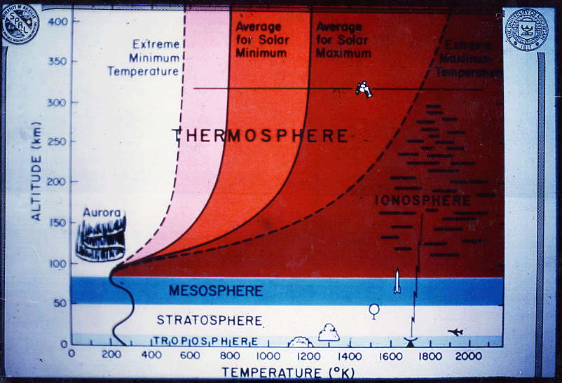

Slide 3
Talk outline
How and why the TGCM’s were developed
at NCAR.
Their present day capability and how they
are being used in CEDAR.
The future modeling efforts in a changing
Climate.

Slide 4
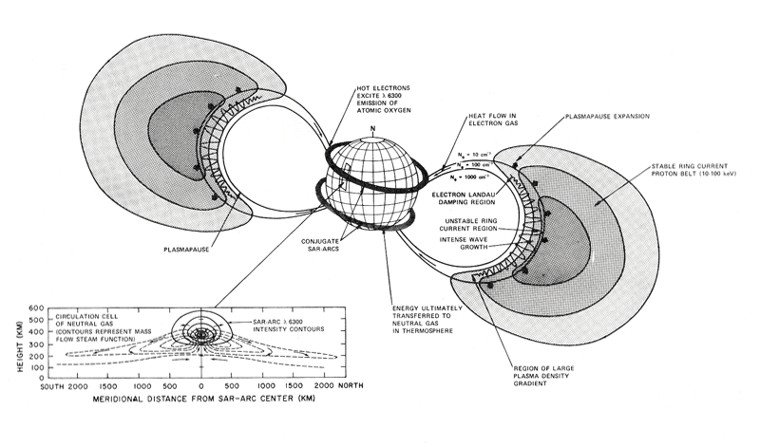

Slide 5
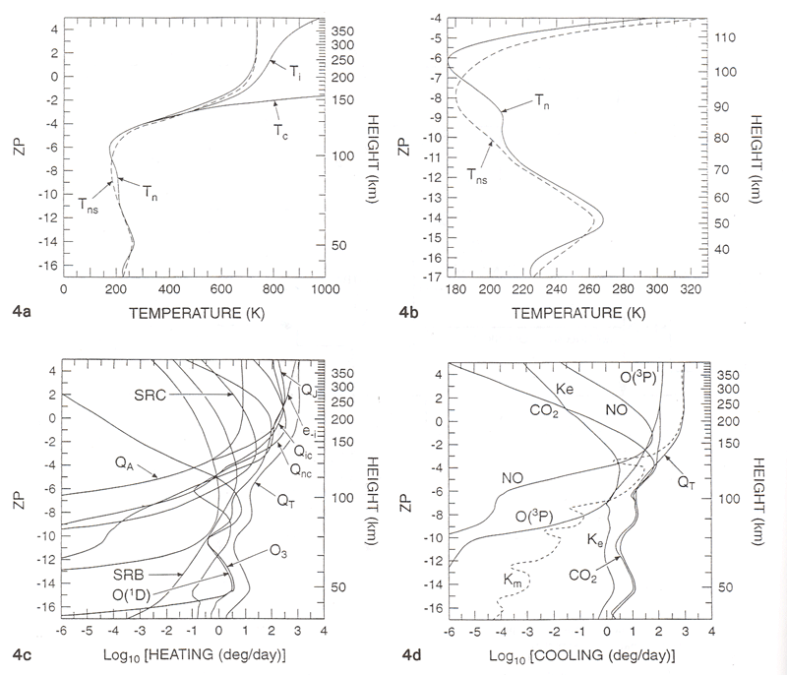

Slide 6
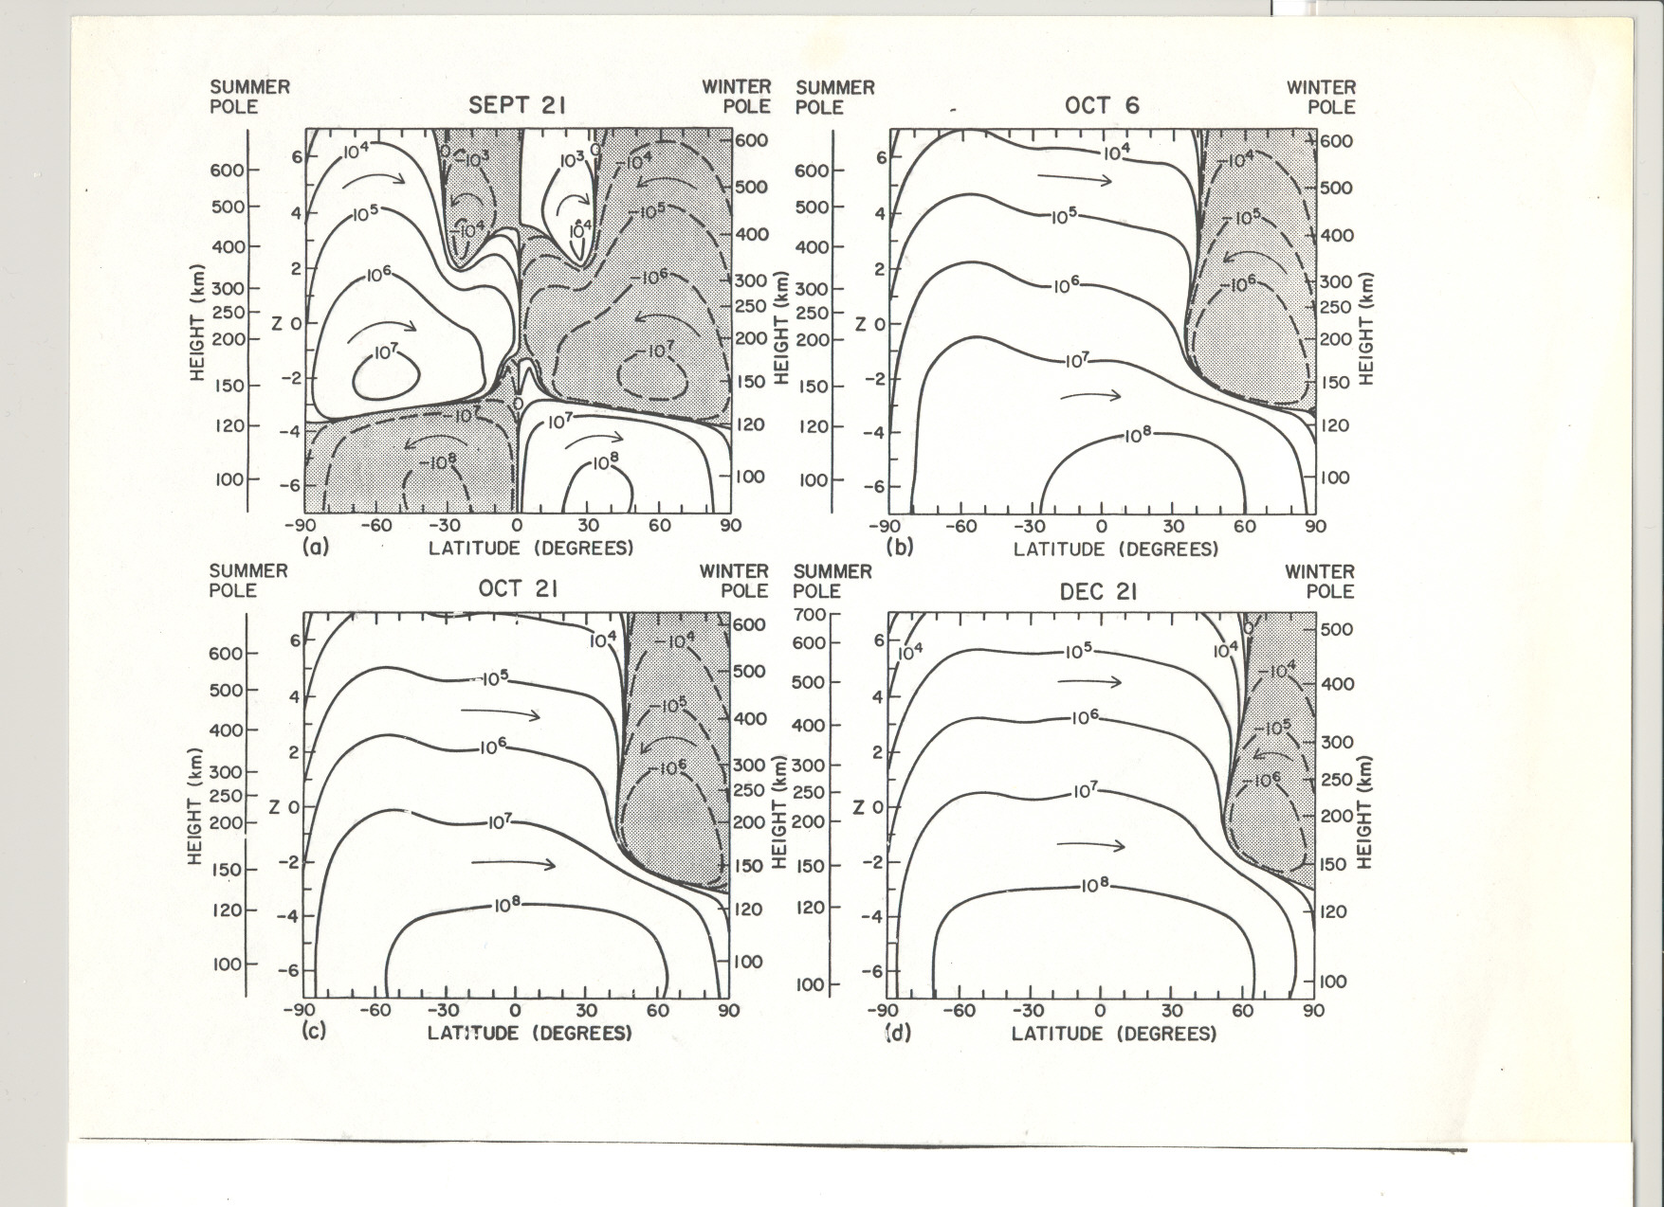

Slide 7
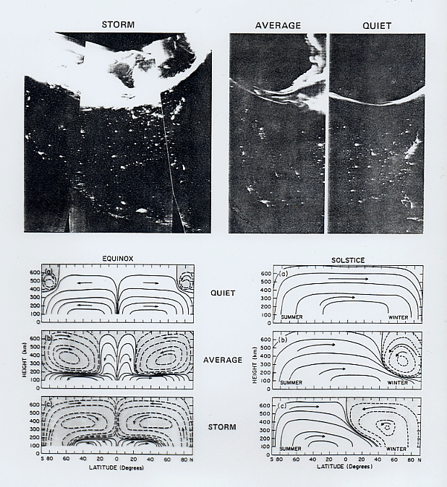

Slide 8
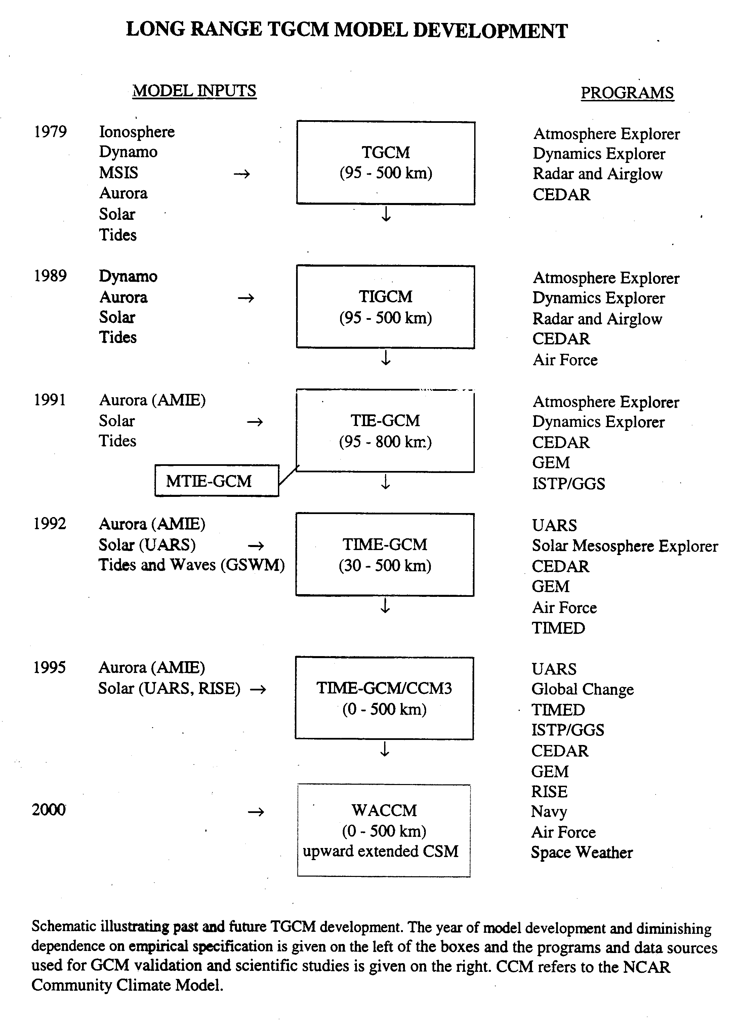

Slide 9
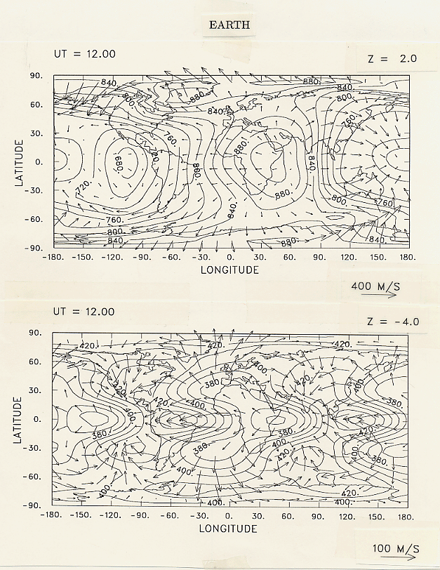

Slide 10
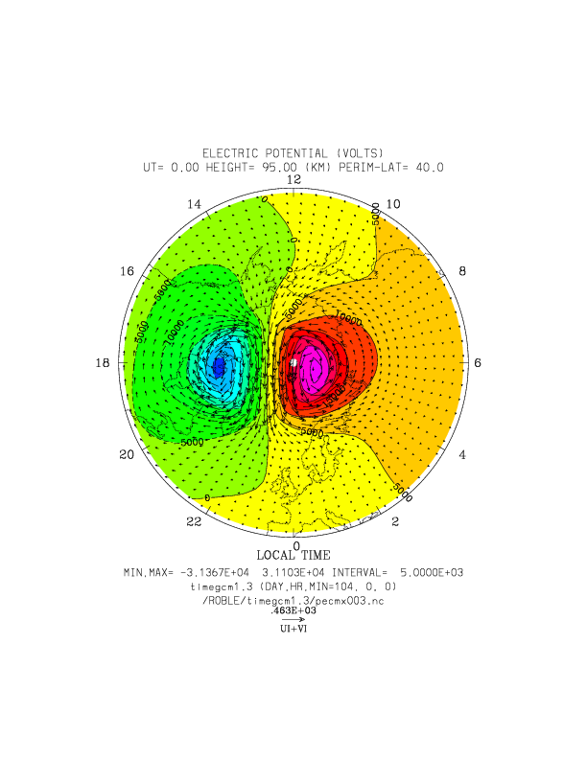

Slide 11
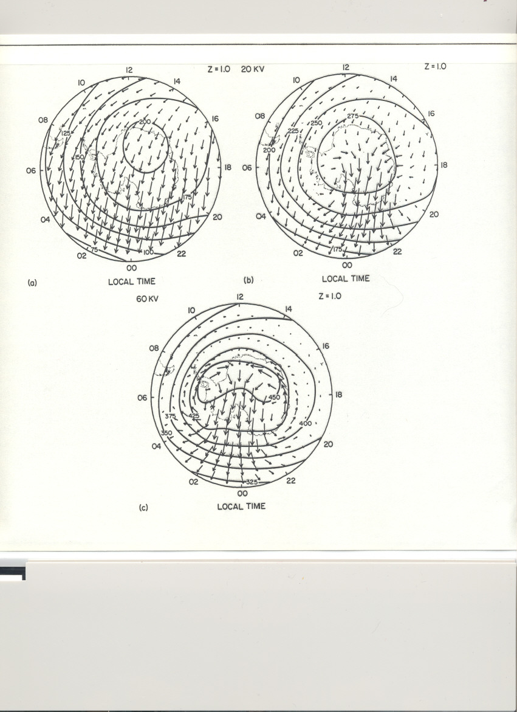

Slide 12
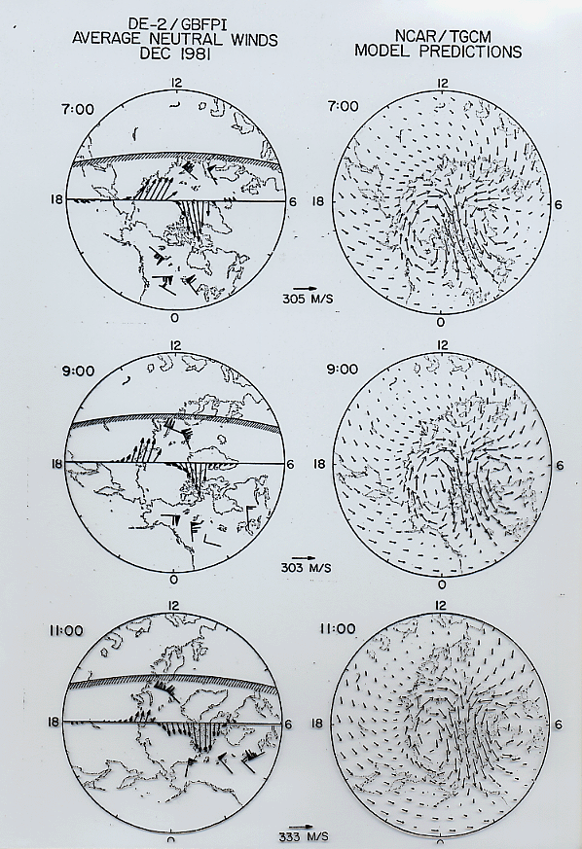

Slide 13
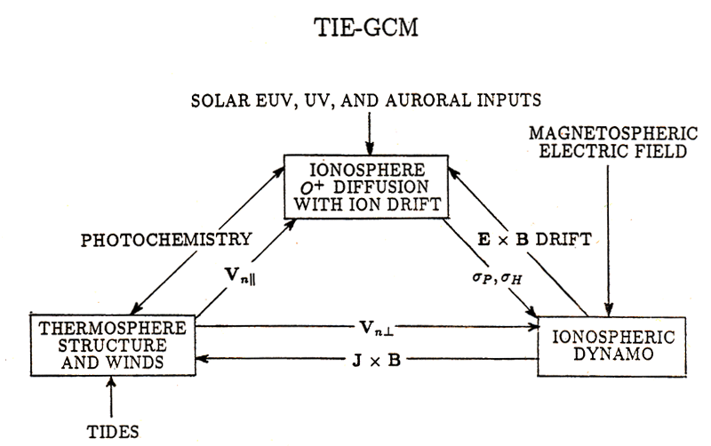

Slide 14
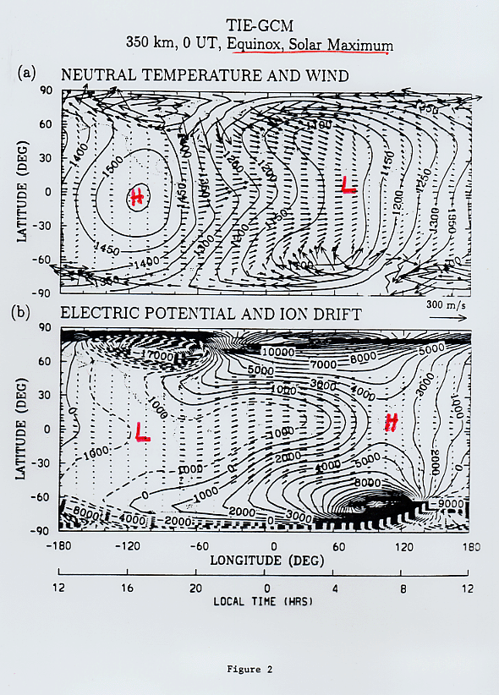

Slide 15
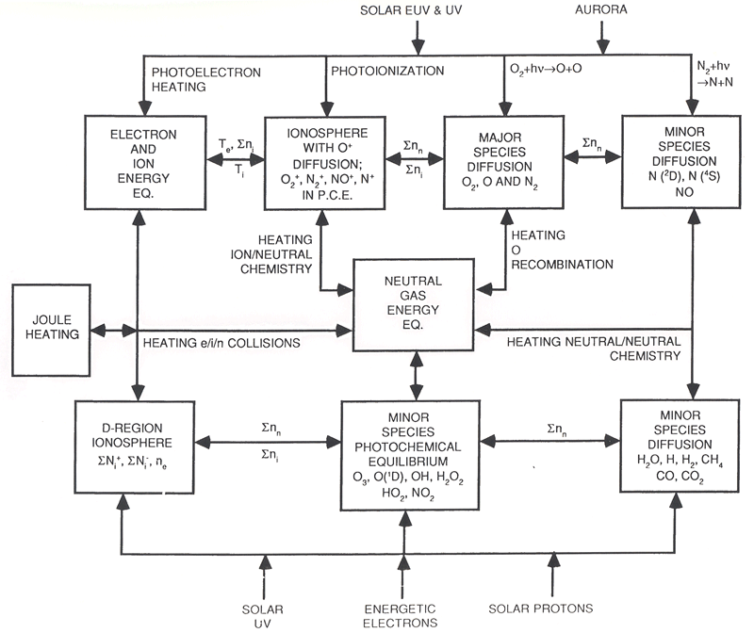

Slide 16
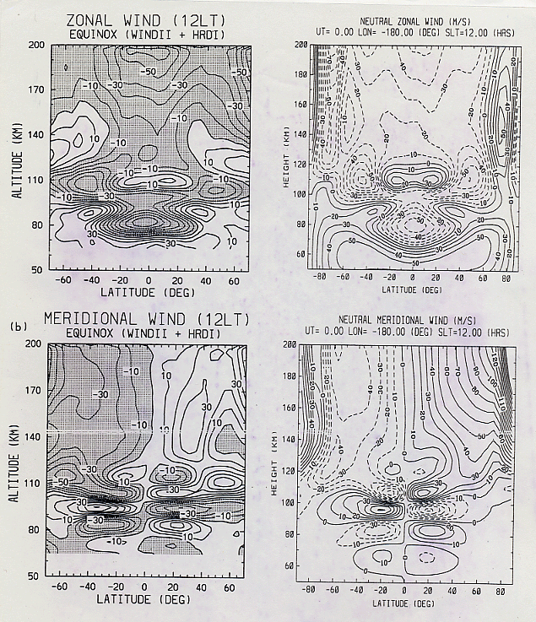

Slide 17
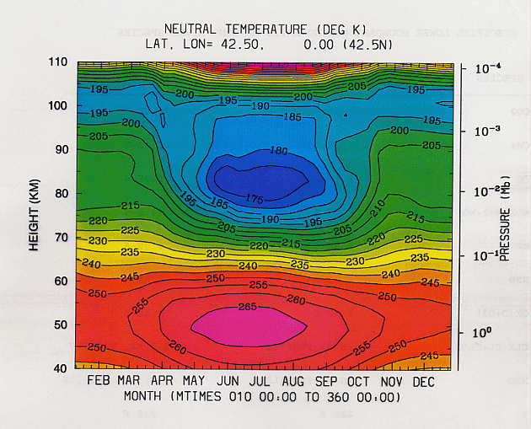

Slide 18
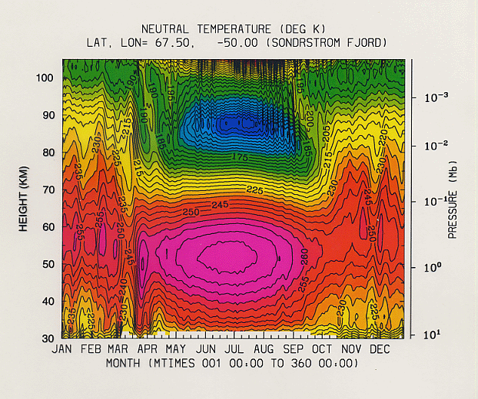

Slide 19
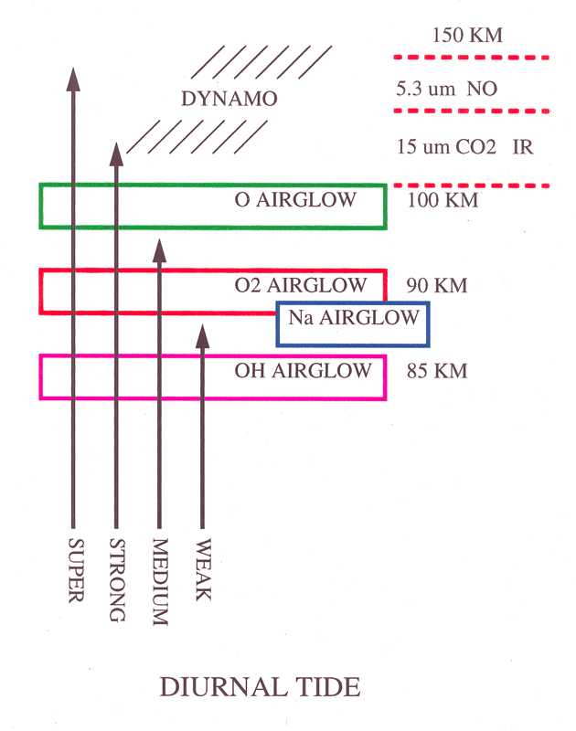

Slide 20
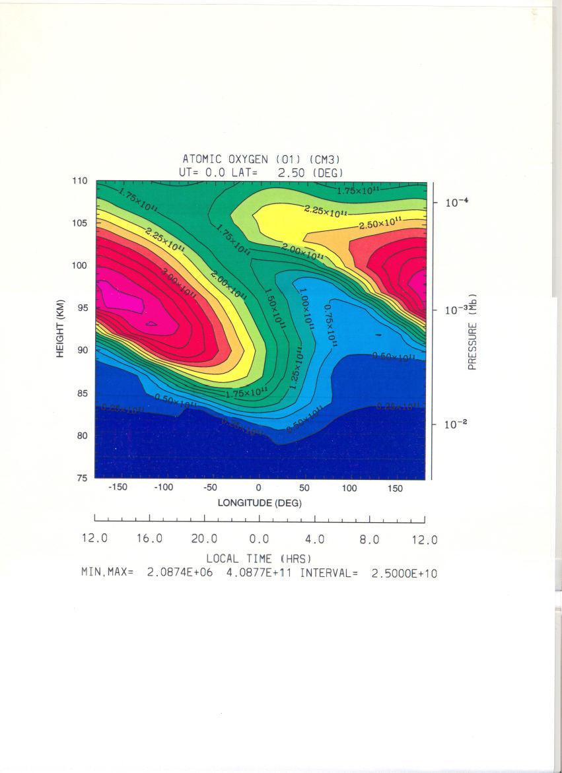

Slide 21
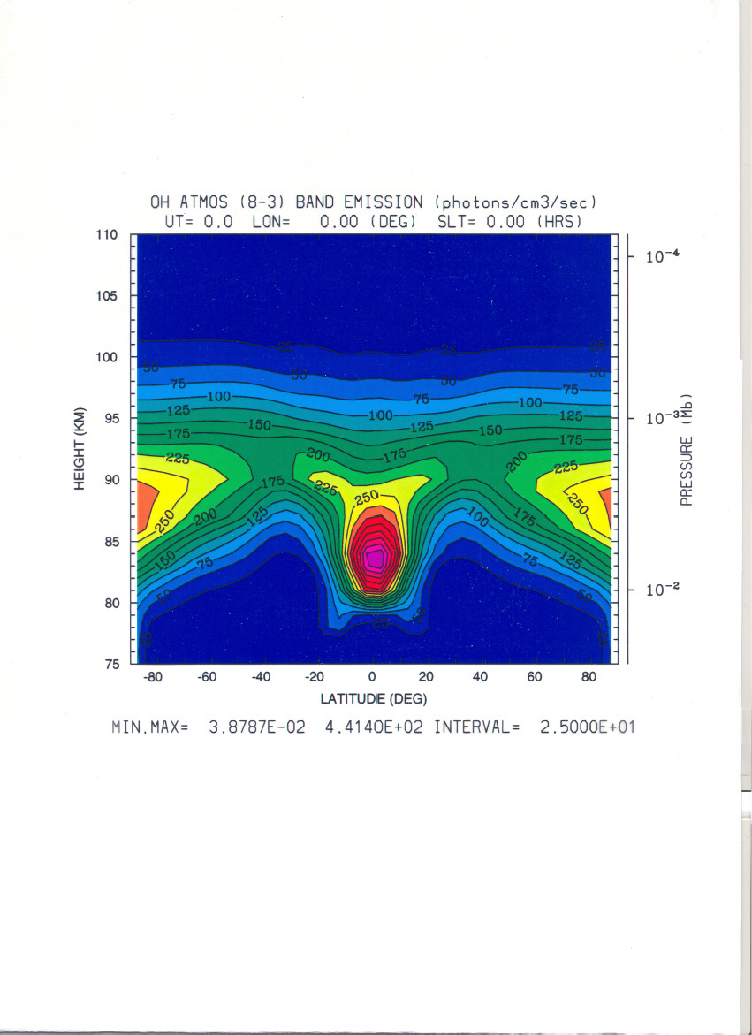

Slide 22
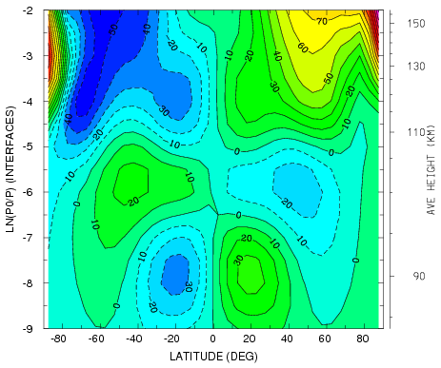
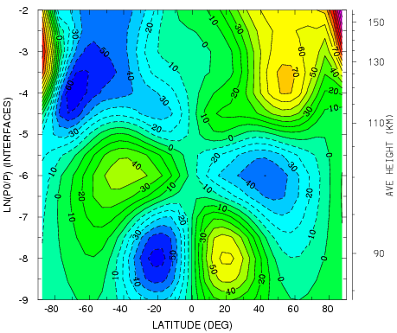
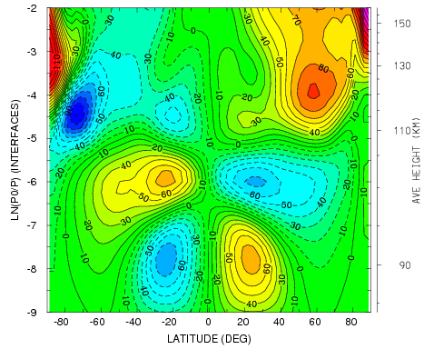
VN SLT=12 AMPLITUDE*1
VN SLT=12 AMPLITUDE*2
VN SLT=12 2.5 deg

Slide 23
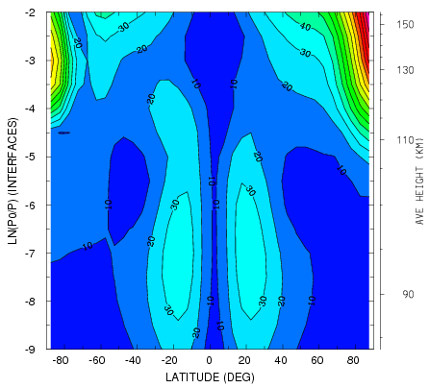
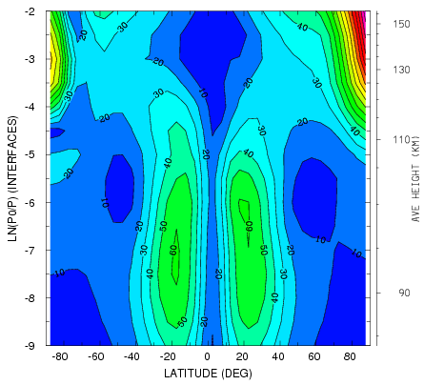
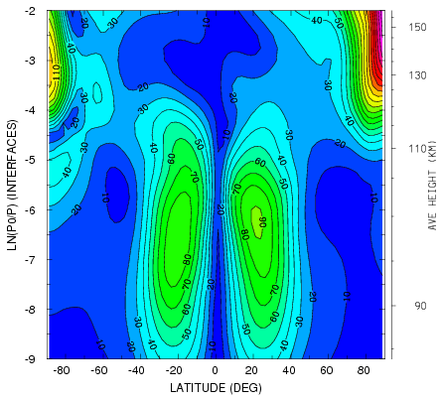
U_{N}
VN WAVE 1 AMPLITUDE*1
VN WAVE 1 AMPLITUDE*2
VN WAVE 1 AMPLITUDE 2.5 deg

Slide 24
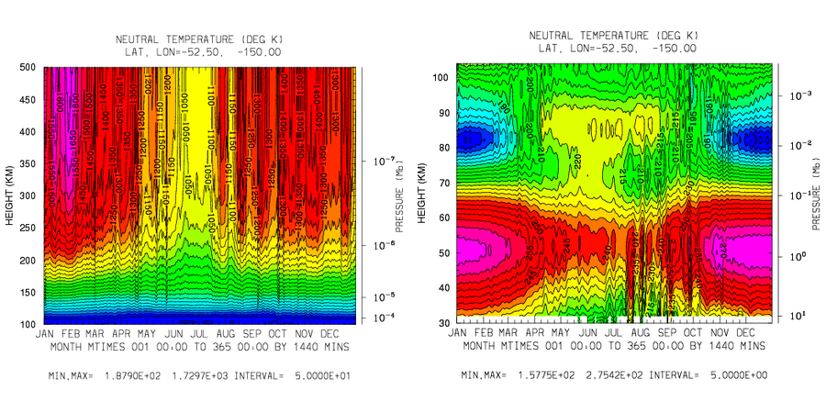

Slide 25
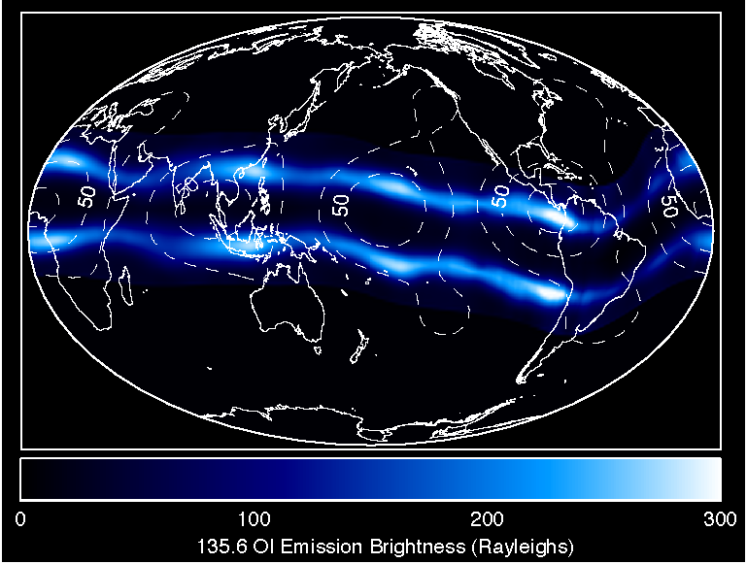
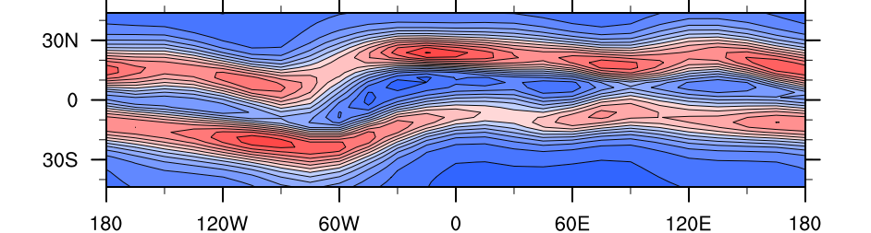
IMAGE FUV Ionospheric Emission
Tropospheric Tidal Effects
in the
Earth’s Ionosphere
March 2002
after Immel et al. (2006)
TIME-GCM Electron Density at 450 km - March
20 LST
after Hagan et al. [2007]

Slide 26
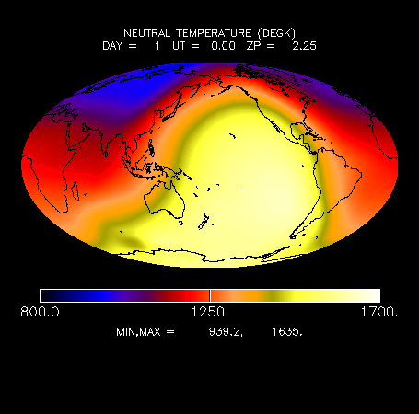

Slide 27
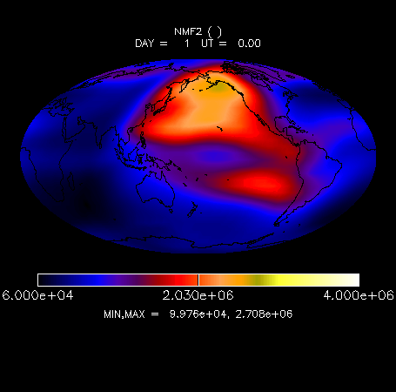

Slide 28
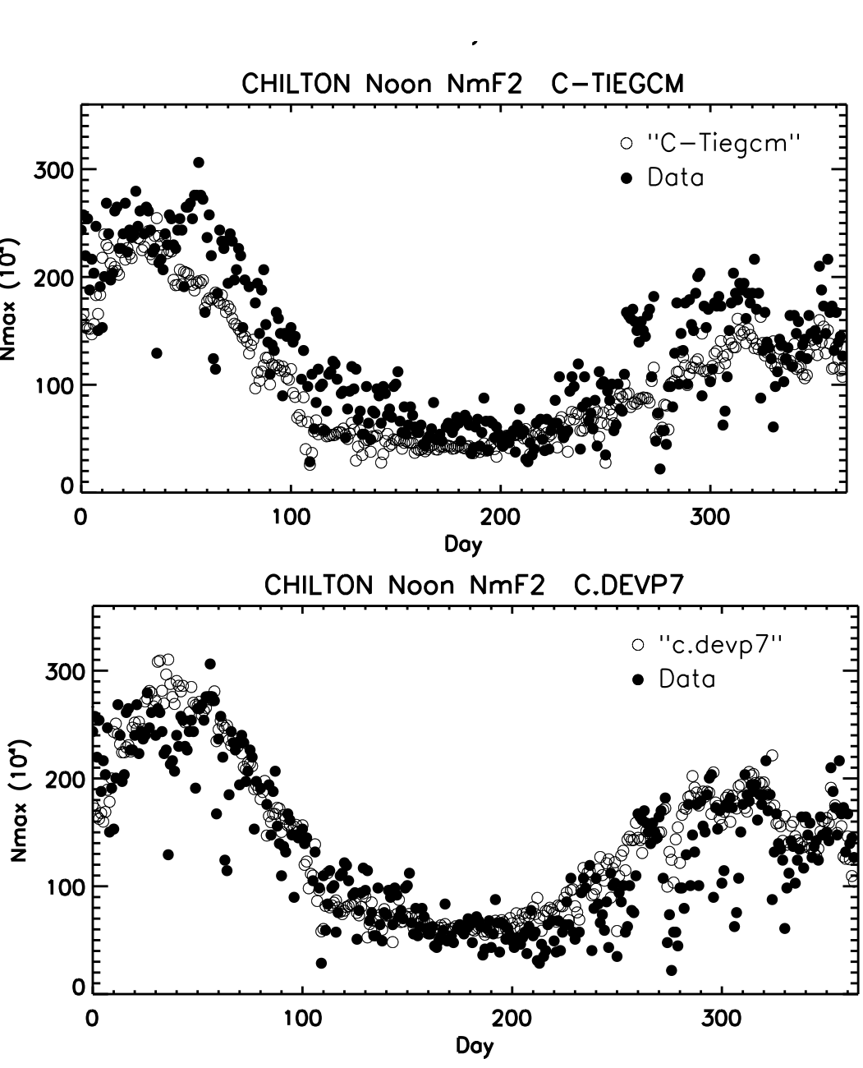

Slide 29
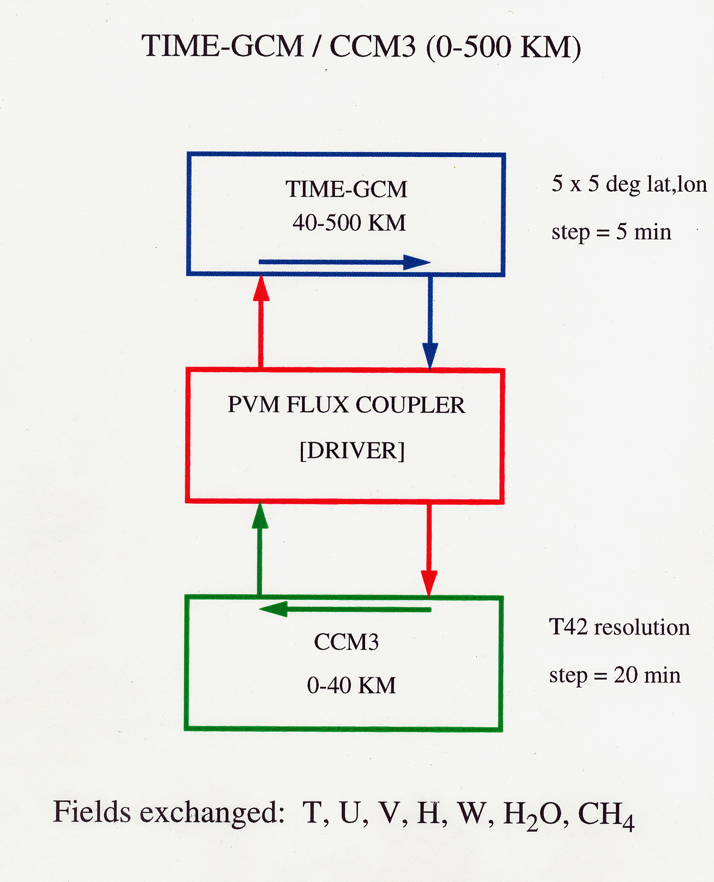

Slide 30
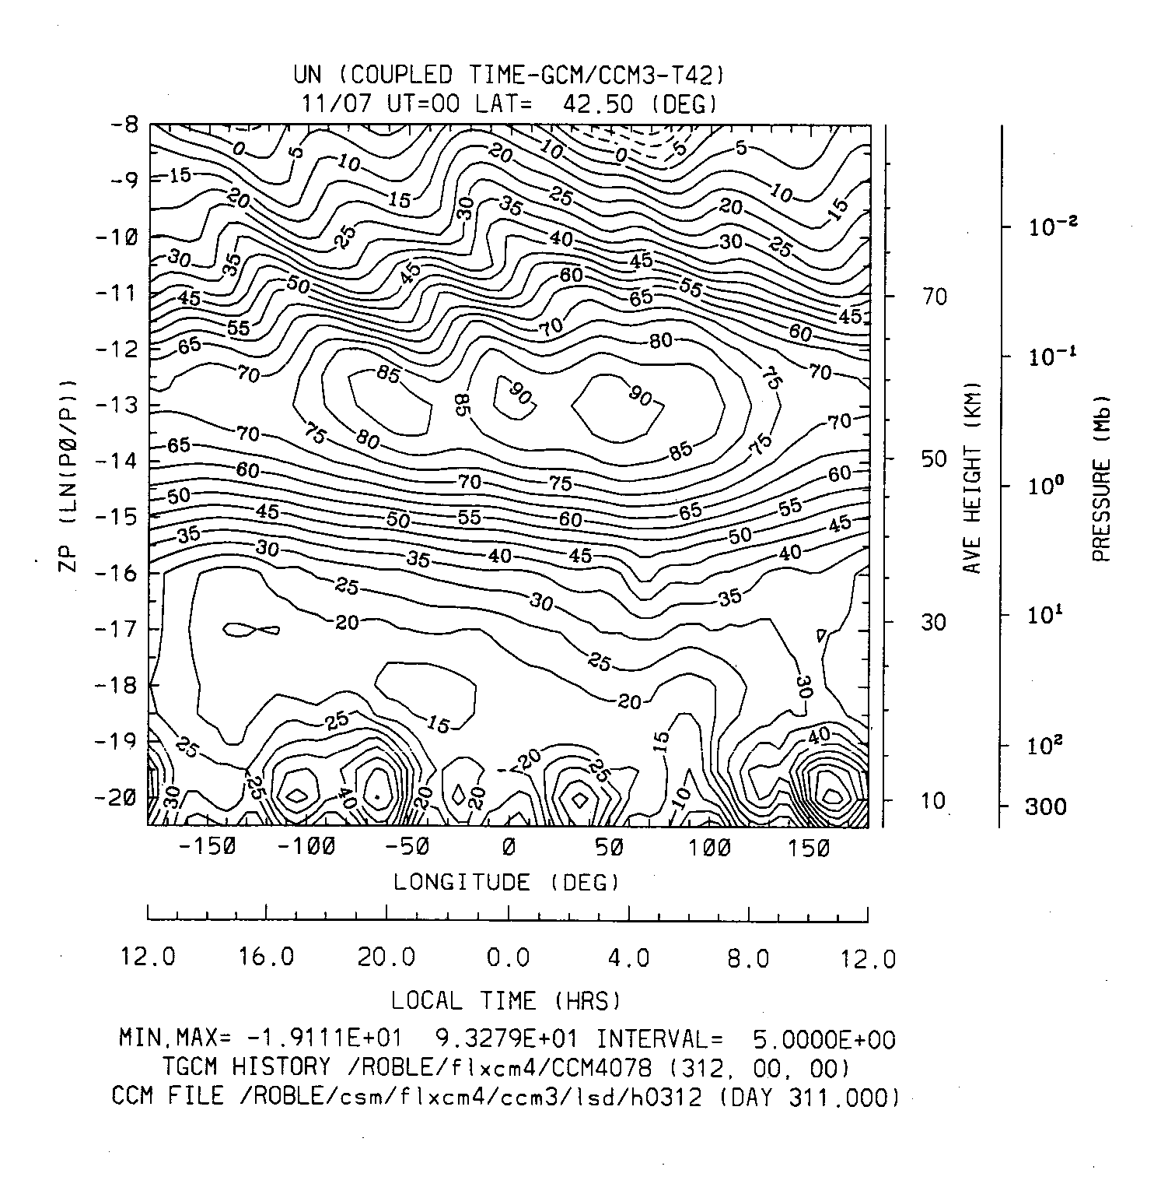

Slide 31
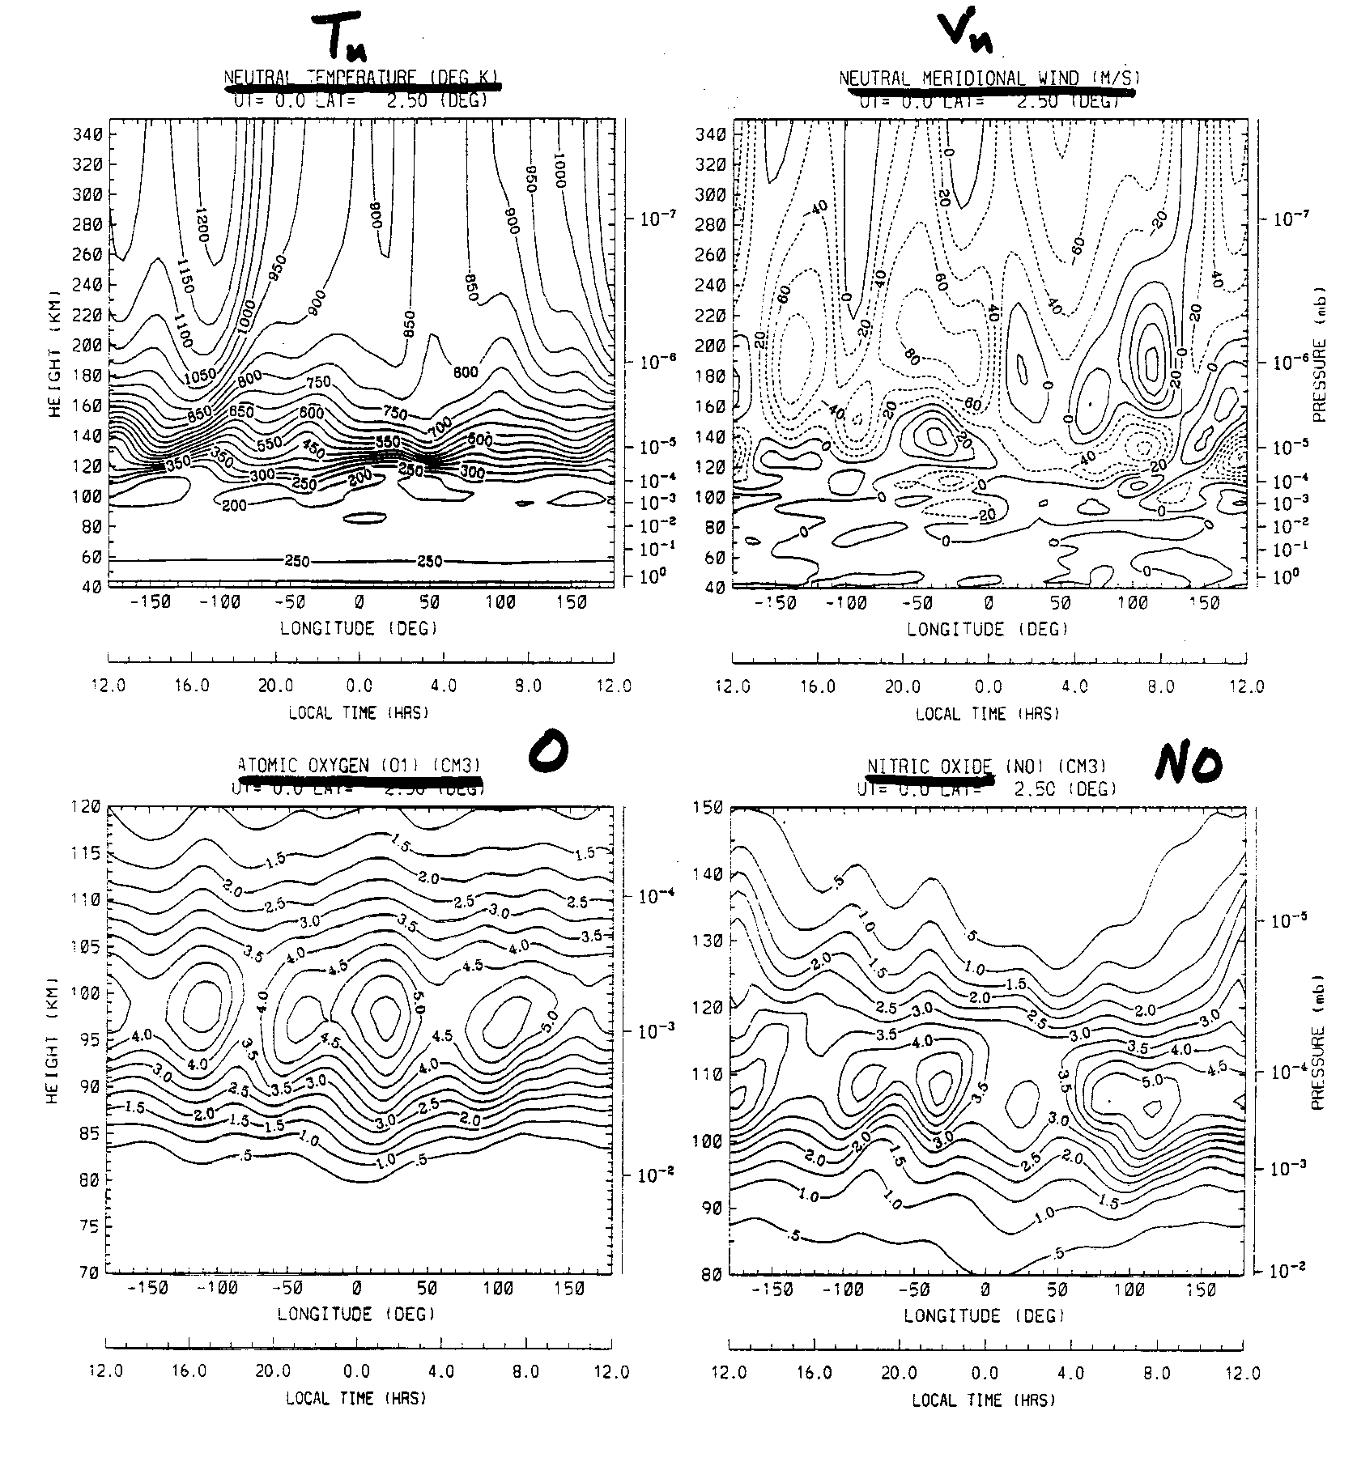

Slide 32
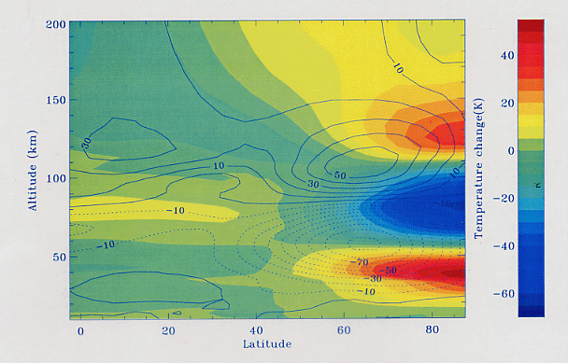

Slide 33
WACCM Components: A collaboration among 3 NCAR Divisions
TIME GCM
HAO
R. Roble
B. Foster
Mesospheric + Thermospheric Processes
MOZART
+
WACCM
Chemistry
(currently offline)
ACD
R. Garcia
D. Kinnison
Dynamics + Physical processes
plus
additonal collaborators
from all three divisions
MACCM3
CGD
B. Boville
F. Sassi
(Middle Atmosphere CCM)

Slide 34
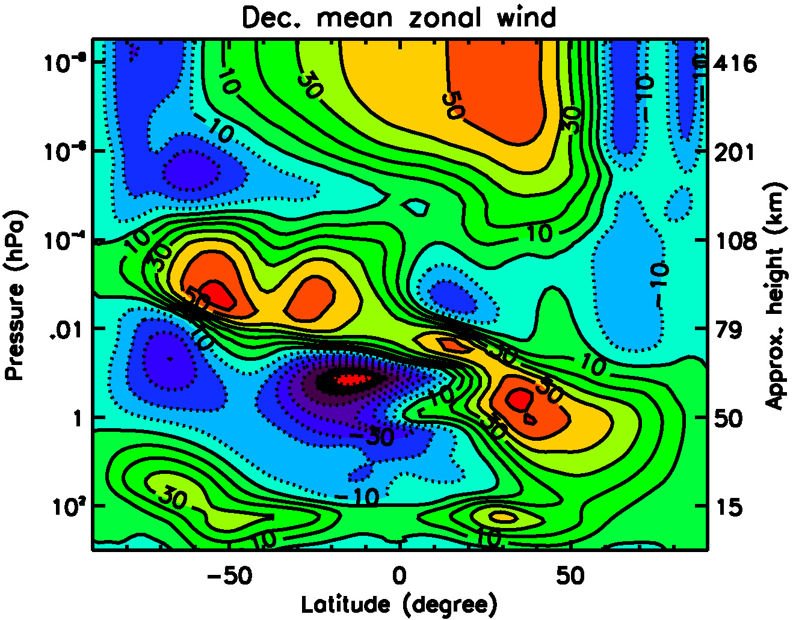
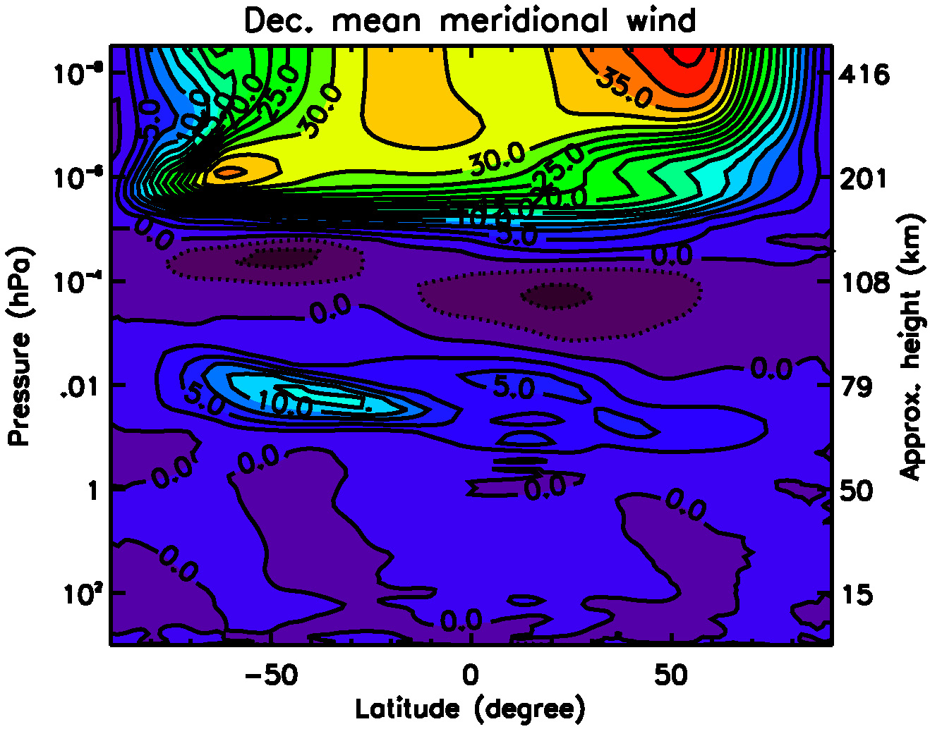
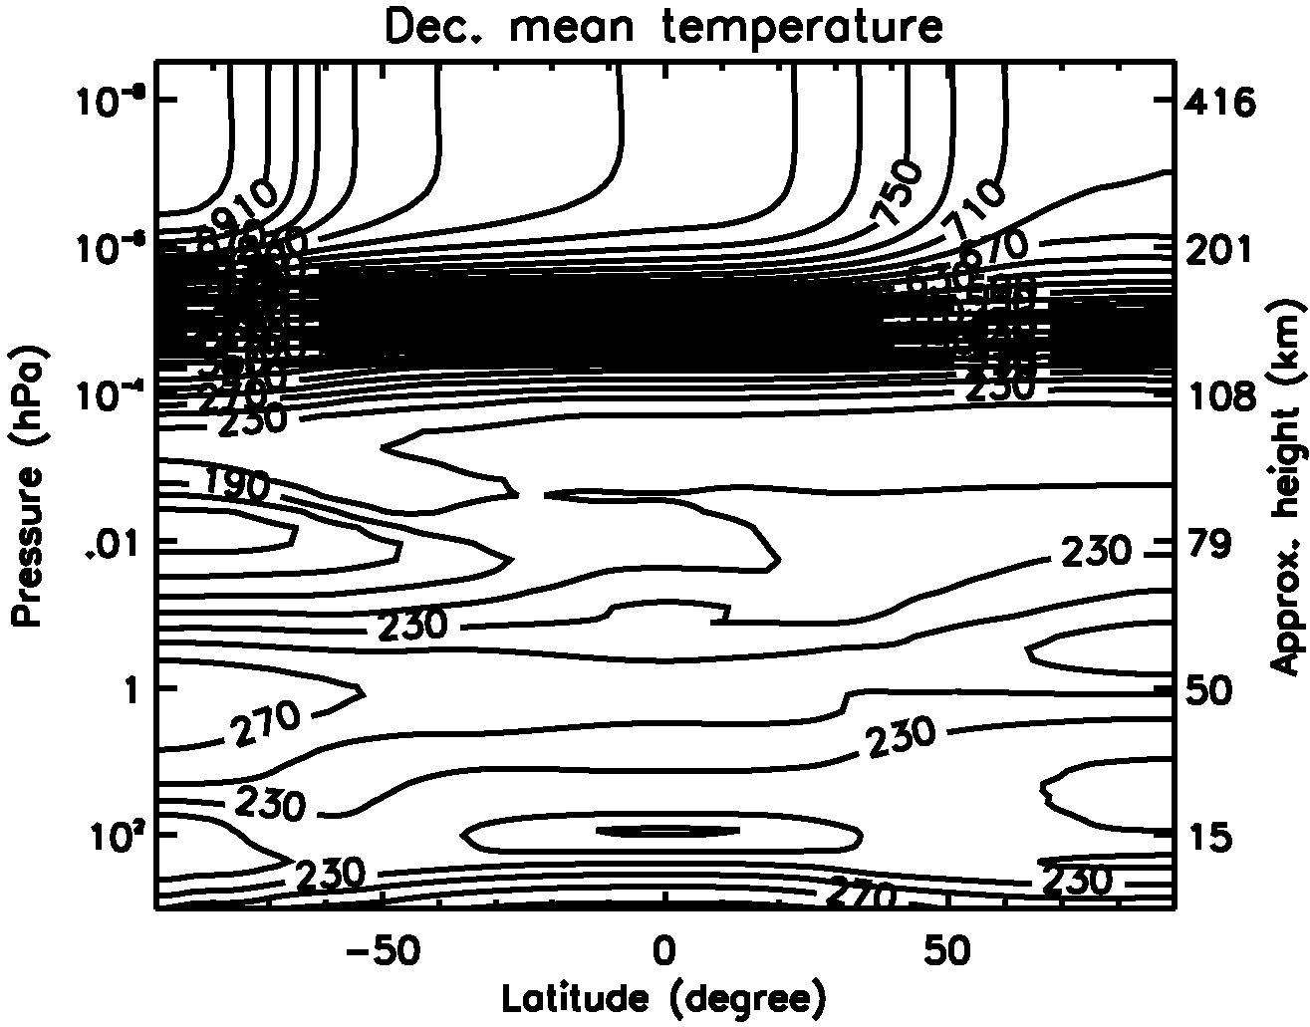
WACCM: Winds and Temperature (December)

Slide 35
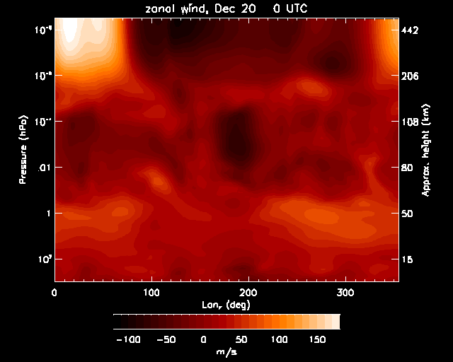

Slide 36
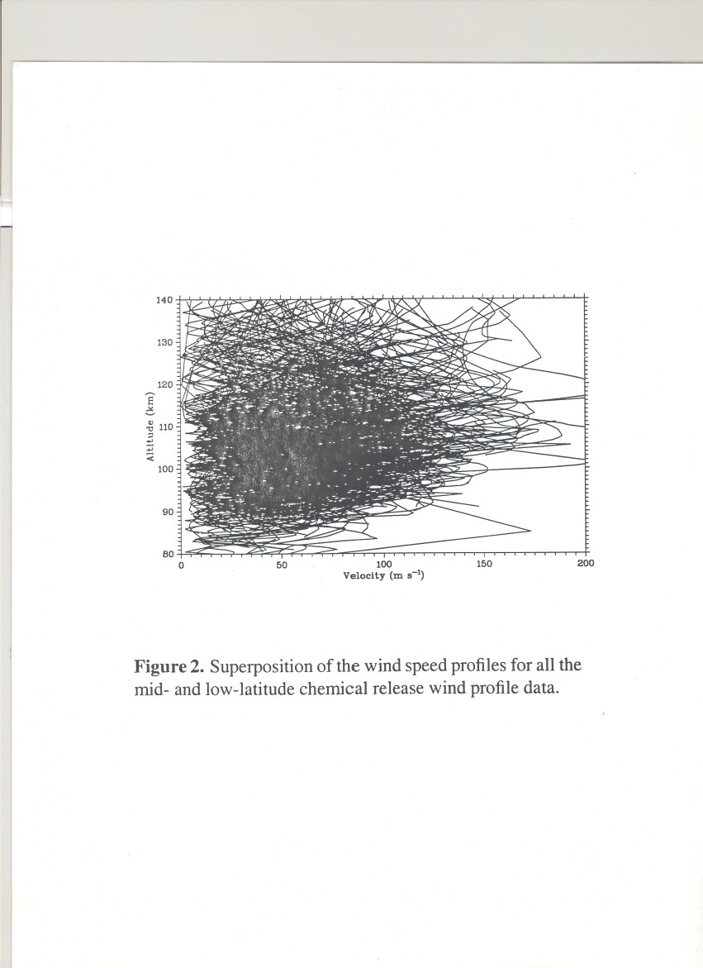

Slide 37
WACCM STUDIES
There are 2 versions of WACCM: Ground-to-140km and Ground-to-500km
WACCM shows that considerable lower atmospheric variability propagates and affects the upper atmosphere and ionosphere
WACCM is a free running climate model whereas TIME-GCM is a campaign model using data at the lower boundary to force the observational period for comparison with ground-based and satellite data

Slide 38
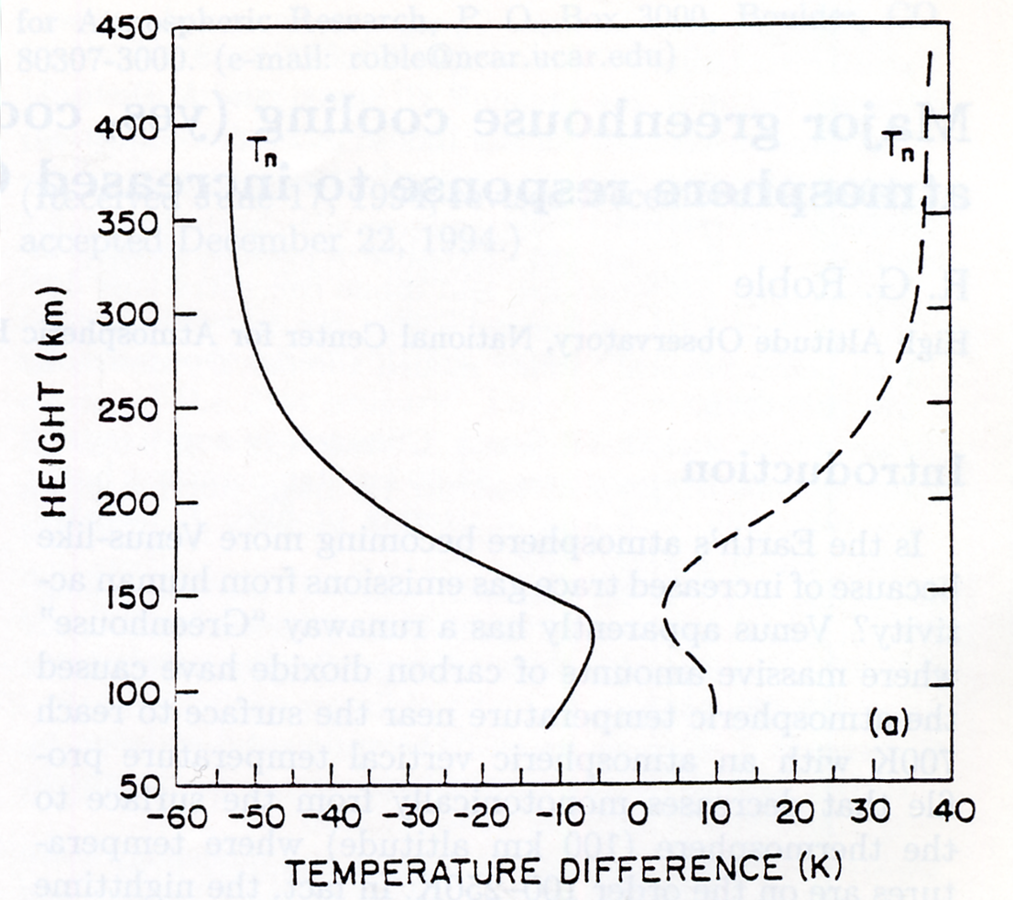
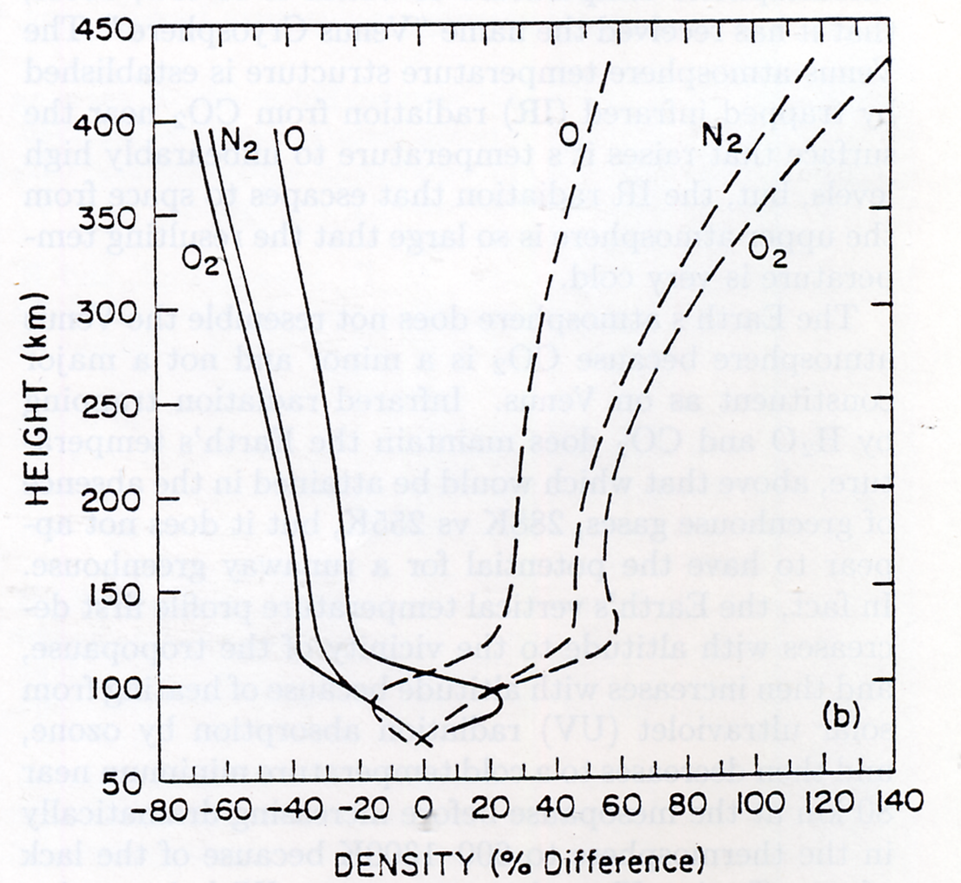
Roble and Dickinson (1989)

Slide 39
Aeronomy of Cooling Processes
• The thermosphere is cooled primarily through radiation from CO₂, NO, and O(³P)
• CO₂ radiation in 15 μm band; NO radiation in 5.3 μm band modulates solar cycle change
• Primary change in recent model estimates is due to increased levels of NO
• Older model estimates were tuned to measurements of NO from SME
Soft X-ray fluxes based on AE-era measurements
• More recent measurements (HALOE, SNOE, ISSAC, HIRASS) ~5 times higher
E.g., peak solar minimum low-latitude density ~3x10⁷ instead of ~6x10⁶
Revised solar soft X-ray fluxes based on TIMED/SEE, SNOE, rockets (EUVAC)
Model with revised ionization and chemistry in agreement with NO measurements
• Key uncertainties in chemical rates pertain to branching between N(²D), N(⁴S)
N₂+e*, NO⁺+e⁻, N(²D)+O
Temperature dependence of N(⁴S)+O₂ and NO+N reactions also important
• All of the cooling reactions are modulated by O, so atomic/molecular balance important
• Current model rate coefficients:
CO₂+O excitation rate:
1.56x10⁻¹² for T_{n} < 260
(2.6-0.004*T_{n})x10⁻¹² for 260<Tn<300
1.4x10⁻¹² for T_{n}>300
NO+O excitation rate:
4.2x10⁻¹¹

Slide 40
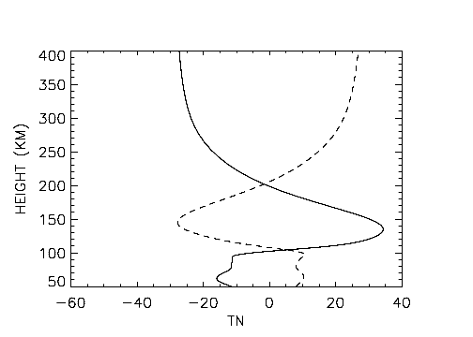
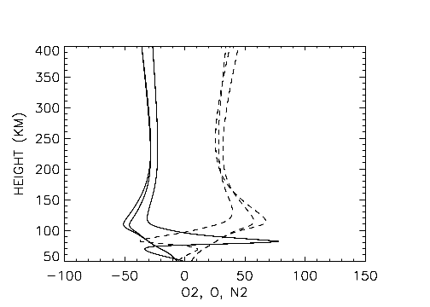
Solar Medium
Difference: Neutral temperature (K)
Percent difference: O2, O, N2
TN
N2
N2
O
O2
O2
Global change minus no change (gc-nc)
Ice Age minus no change (hc-nc)

Slide 41
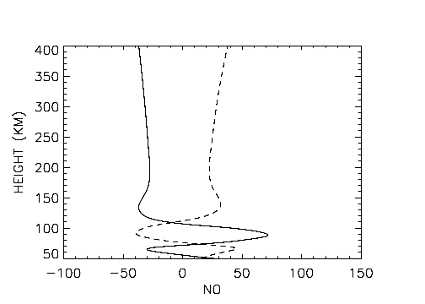
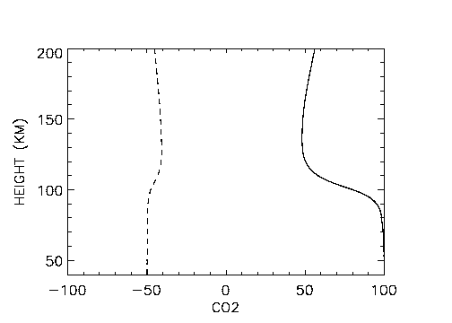
Solar Medium
Percent difference: NO
Percent difference: CO2
Global change minus no change (gc-nc)
Ice Age minus no change (hc-nc)

Slide 42
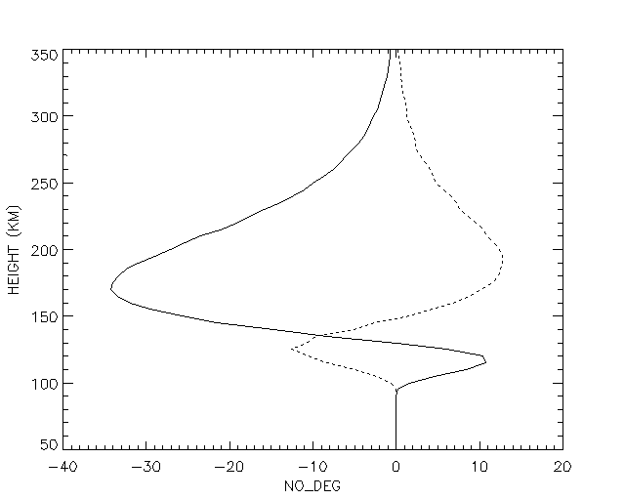
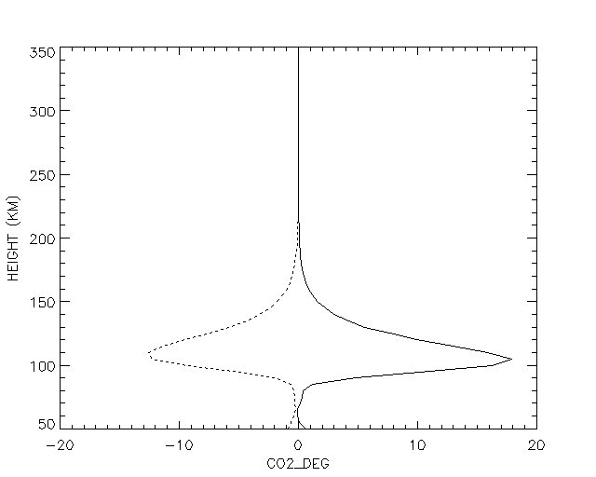
Change in NO and CO2 cooling
5.3 micron NO cooling (deg/day)
15 micron CO2 cooling (deg/day)
NO
CO2
Global change minus no change
Ice Age minus no change

Slide 43
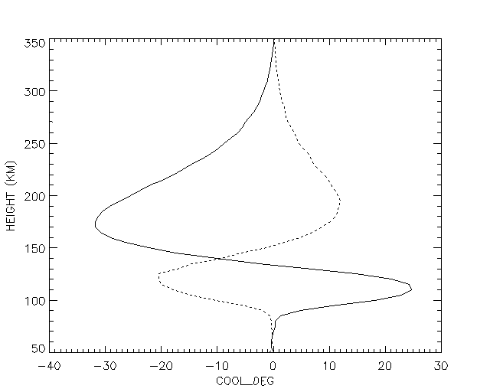
Change in total cooling (deg/day)
TCOOL
Global change minus no change
Ice Age minus no change

Slide 44
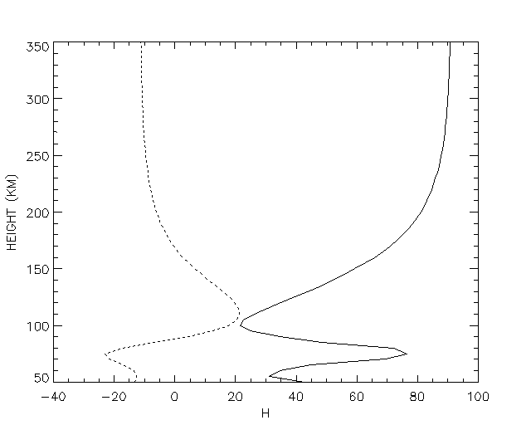

Percent change: H (cm3)
Percent change: NE (cm3)
H
NE
Global change minus no change
Ice Age minus no change

Slide 45


Solar Minimum
Difference: Neutral temperature (K)
Percent difference: O2, O, N2
O
TN
N2
N2
O2
O2
Global change minus no change (gc-nc)
Ice Age minus no change (hc-nc)

Slide 46
Conclusions
• Increased CO₂ and CH₄ levels will cool and contract the upper atmosphere, but the effects vary as a function of altitude, with some altitudes actually warming.
• Effects of NO cooling and chemical heating modulate the thermospheric response to global change as well as to the solar cycle.
• Largest changes are predicted to occur during solar minimum conditions.
• These findings may be commensurate with early inference of density changes from satellite orbit analysis.

