Slide 1
TIEGCM Community Release of Version 1.94
Ben Foster
June, 2011 CEDAR Workshop

Slide 2
With acknowledgements to the TIEGCM development group at HAO/AIM:
Stan Solomon, Art Richmond, Ray Roble,
Wenbin Wang, Barbara Emery, Astrid Maute,
Alan Burns, Liying Qian, Qian Wu, Peter Schmitt,
Mike Wiltberger, Hanli Liu, Joe McInerney
See also the Contact Information page of the User’s Guide

Slide 3
Thermosphere-Ionosphere-Electrodynamics GCM
The TIEGCM is a first-principles numeric simulation model of Earth’s Thermosphere-Ionosphere system. The model uses a time-dependent finite-differencing method on a 3-d spatial grid to solve the fundamental equations of hydrodynamics, thermodynamics and continuity.
This talk will focus on:
Version 1.94, released June 3, 2011
Selected results from the v1.94 Benchmark Runs
Future development goals
For more information about the NCAR/HAO TGCM Models, please see
http://www.hao.ucar.edu/modeling/tgcm

Slide 4
Summary of v1.94 Release Notes
Weimer 2005 Electric Potential Model
For auroral parameterization and transition to high-latitude ion convection
Optionally driven by OMNI IMF data Bx, By, Bz, Swvel, Swden
See Weimer Agreement, and Weimer05 in the TIEGCM model
New build/compile system (scripts directory)
Make.machine files for platform-specific compilers and libraries
Support for Intel ifort/OpenMPI on 64-bit Linux systems (Make.intel_hao64)
Simplified Makefile without platform-dependent conditionals
New module saves diagnostics to secondary history files
22 “sanctioned” diagnostic fields are available in v1.94 (diags table)
Benchmark Runs by v1.94 are released for validation and testing
Seasonal steady-state histories for model start-up (solar min and max)
Five-day control runs, started from the seasonal steady-state histories
Full year climatology (constant solar forcing)
Data-driven storm cases: dec2006, nov2003, whi2008
All new User’s Guide, Release Document, and Model Description

Slide 5
TIEGCM Directory Structure
User Working Directory
Model Directory
(tiegcm1.94)
Data Directory
(tiegcm1.94_data)
src/
scripts/
doc/
netCDF Files
Start-up Histories:
Steady-state Seasonal
Benchmark Runs
Data input files:
GPI (Kp, f10.7)
IMF (Bx,By,Bz,Swvel,Swden)
GSWM (Tides)
Other
*.F
*.h
*.job
*.inp
Make*
Utilities
README
Userguide
Release Doc
Description

Slide 6
Quick-Start Procedure see also Quick-start chapter of the User's Guide
Obtain and build the model, and execute a default run:
Download and extract model and data tar files (download page)
Set modeldir and other shell variables in the job script tiegcm-linux.job
Set env var TGCMDATA to the data directory (.cshrc file or job script)
Execute by typing “tiegcm-linux.job &” (build and execute default run)
Rename and edit namelist input file tiegcm_default.inp for a new run
User Working Directory
[tiegcm_project]
Stdout files *.out
tiegcm-linux.job
tiegcm_default.inp
other
Model directory
[tiegcm1.94]
Exec directory
[tiegcm-linux]
src/
scripts/
doc/
tests/
*.o
*.mod
*.nc
other
History file output

Slide 7
Selected results from a tiegcm1.94 Benchmark Run: November 19-23, 2003 Storm
These figures were made with post-processors
tgcmproc_f90 and tgcmproc_idl, both of which are
available on the TGCM download website
For more plots and movies of Benchmark Runs, please see
tiegcm1.94 Release Document
netCDF output files are available for download at the
NCAR Community Data Portal

Slide 8
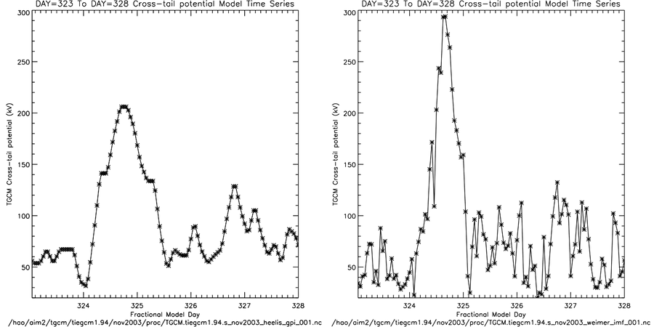
Cross-Tail Potential (kV): Nov 19-23, 2003
Heelis/GPI
Weimer/IMF
295 kV
210 kV
Min,Max = 32, 206
Min,Max = 20, 294
ctpoten = 15+15*Kp+0.8*Kp^2
ctpoten = Cross-cap potential drop from
Weimer model (hemispheric average)

Slide 9
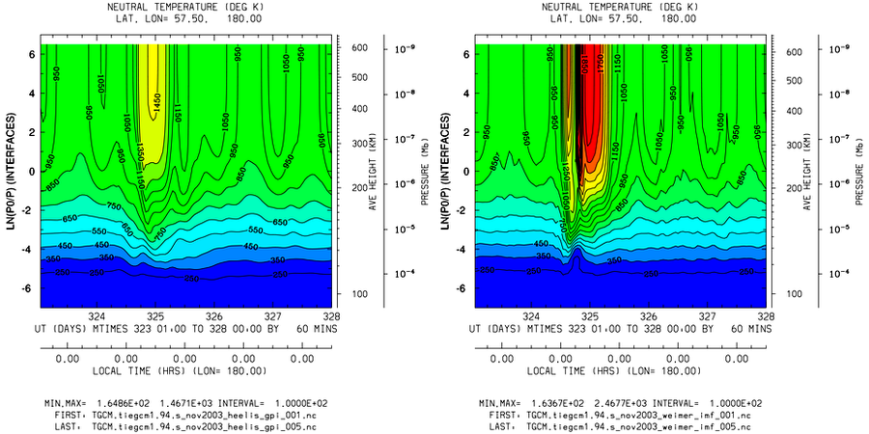
Selected Results: tiegcm1.94 Benchmark Runs
November 19-24, 2003
Ut vs Zp: TN (deg K) at Latitude 60N
Heelis/GPI
Weimer/IMF
Min,Max = 165, 1467 Interval=100
Min,Max = 164, 2468 Interval=100

Slide 10
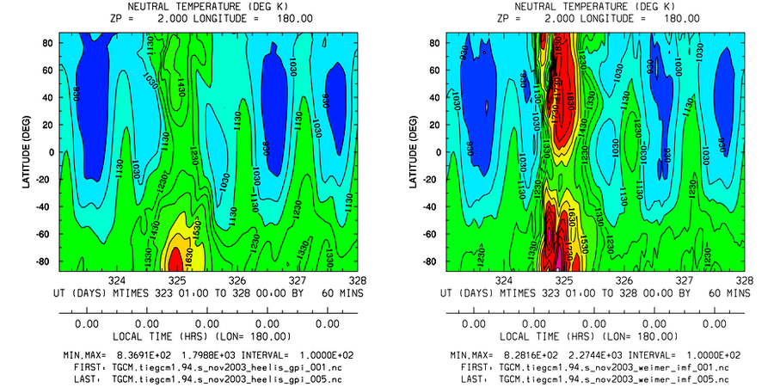
Selected Results: tiegcm1.94 Benchmark Runs
November 19-24, 2003
Ut vs Latitude: TN (deg K) at Zp +2
Heelis/GPI
Weimer/IMF
Min,Max = 837, 1800 Interval=100
Min,Max = 828, 2274 Interval=100

Slide 11
Global TN at Zp +2 (~350-450 km) Nov 19-24, 2003 (hourly frames)
Heelis/GPI
Weimer/IMF

Slide 12
Future Development (software)
Near-Term:
Validation and tuning of the 2.5 degree “double resolution” model
Performance and scaling improvements (FFT, memory structure, etc.)
Mid-Term:
Parallel dynamo solver
NetCDF 4.0 with parallel i/o
Ongoing and Long-Term:
Post-processing, visualization and analysis
Continued Community Support (CCMC, University users)
Further improvements to the User’s Guide and Model Description
More frequent minor and intermediate releases of the source code?

