Slide 1
Energetics and Composition in the Thermosphere
A. G. Burns, W. Wang, S. C. Solomon and L. Qian

Slide 2
Major Species Continuity Equations (O and O₂)
Molecular diffusion
Horizontal advection
Vertical advection
S is the loss of O₂ through photodissociation and the loss of O through three body recombination. Short term changes in O and O₂ are dominated by the transport processes (e.g., Rees, 1989), so only these will be discussed here.

Slide 3
Neutral Energy Equation
Downward heat conduction
Heat advection
Compressional heating and cooling by expansion
Joule heating
Thermospheric heating (Q) includes solar radiation heating, Joule heating, collisional heat transfer and heat release by chemical reactions. Energy loss (L) process is primarily radiation cooling (NO, O(³P) and CO₂)

Slide 4
Minor Species Continuity Equations (NO and N(⁴S))
The NCAR-TIEGCM solves for NO, N(4S) and N(2D)
The NCAR-TIME-GCM additionally solves for H in the upper thermosphere and a multitude of species in the lower thermosphere and mesosphere (see Roble, 1995)

Slide 5
Boundary Conditions for Thermosphere Equations:
Upper boundary conditions:
Diffusive equilibrium for U, V, W, T, Ψ_{O2}, Ψ_{O}
Chemical equilibrium for N(4S) and NO
Lower boundary conditions:
specified using the global scale wave model (GSWM)
U and V: specified by tides
T: 181 K + perturbations introduced by tides
O₂: fixed mixing ratio of 0.22
O: gradient of the mixing ratio is zero
N(4S): chemical equilibrium
NO: constant density of 8x10⁶

Slide 6
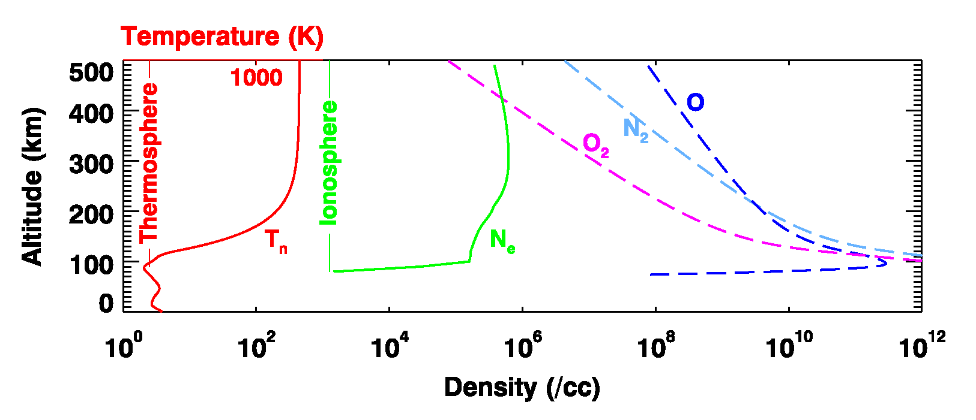
The Thermosphere/ionosphere System

Slide 7
What Drives the Temperature Structure of the Thermosphere
Roble et al., 1987

Slide 8
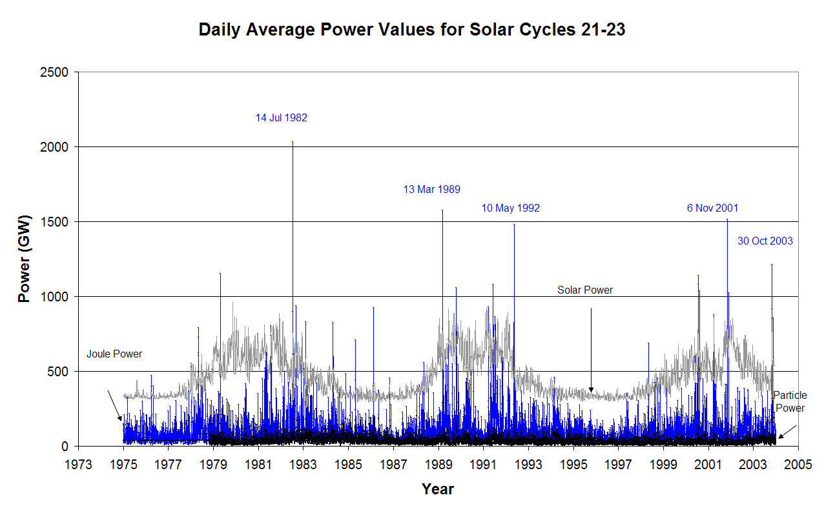
Forcing the Thermosphere
Knipp et al, 2004

Slide 9
Changes in Major Species Neutral Composition

Slide 10
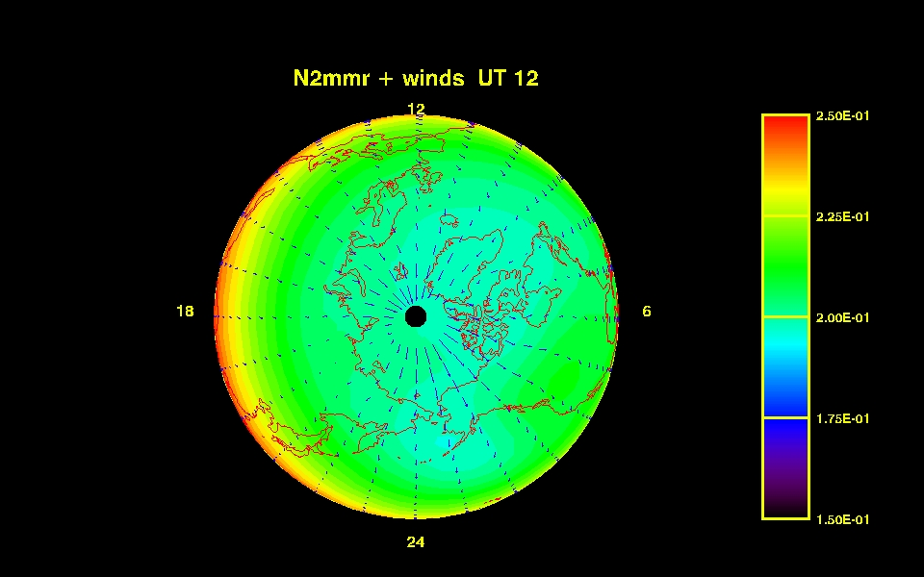
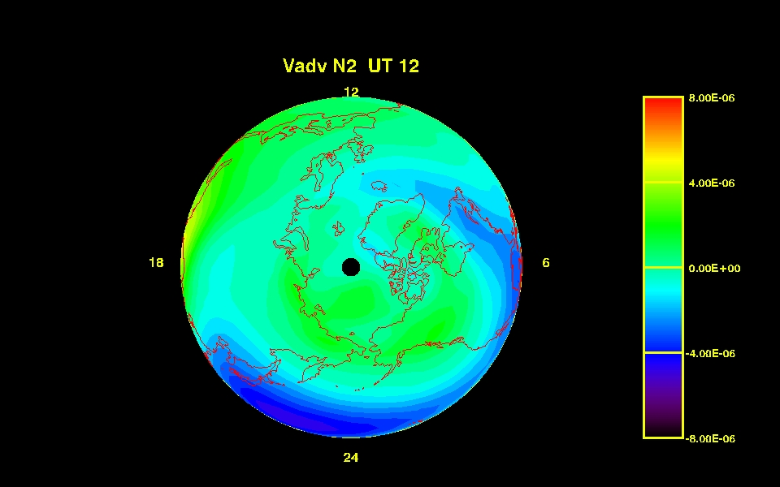
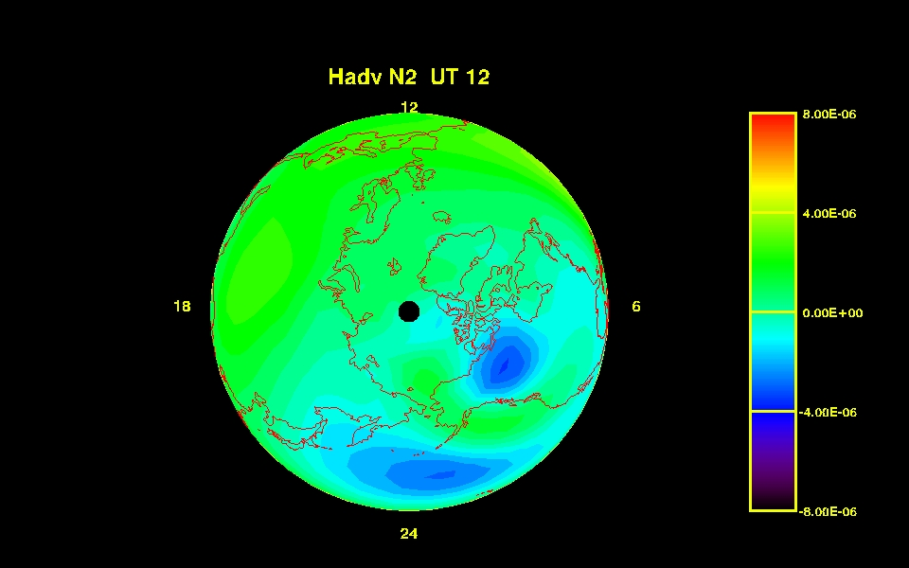
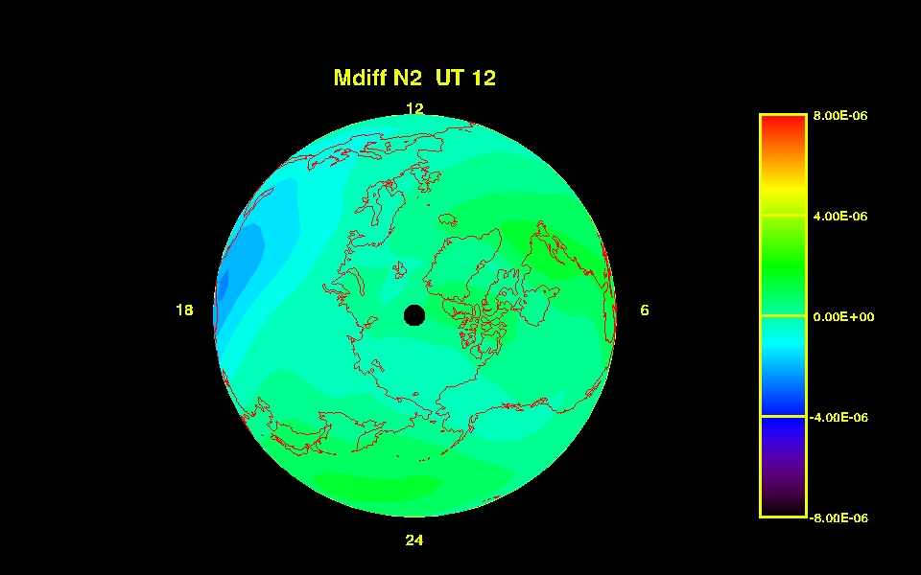
N₂ mmr and forcing in quiet time
N₂ mmr
Vertical Advection
Horizontal Advection
Molecular Diffusion

Slide 11
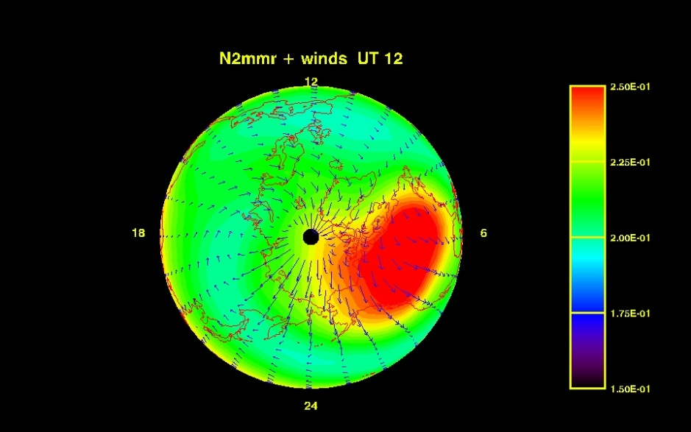
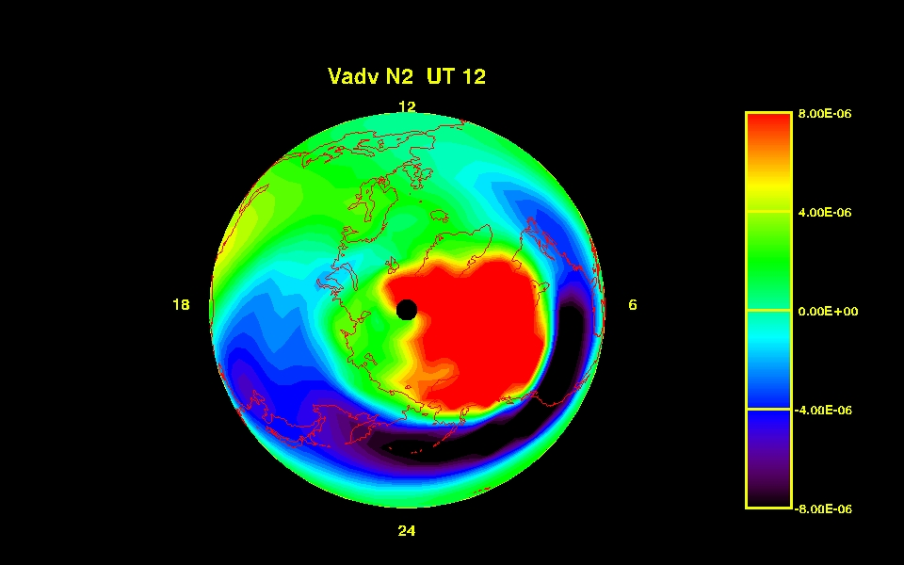
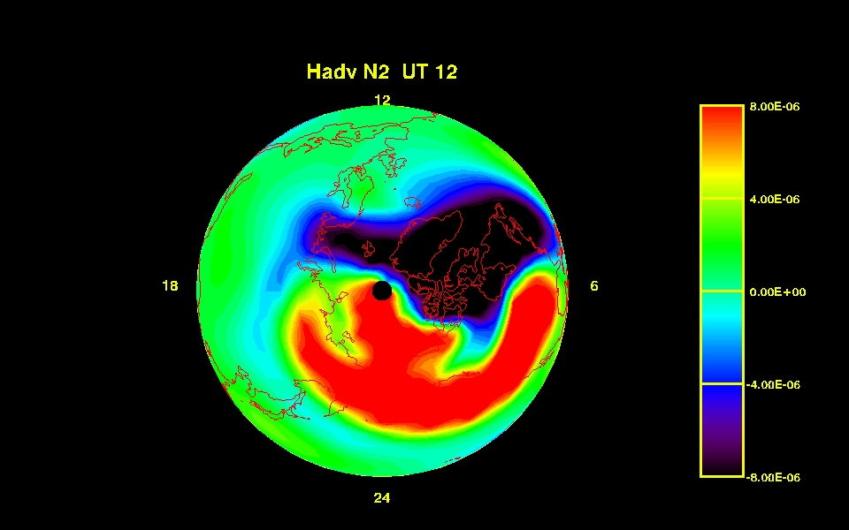
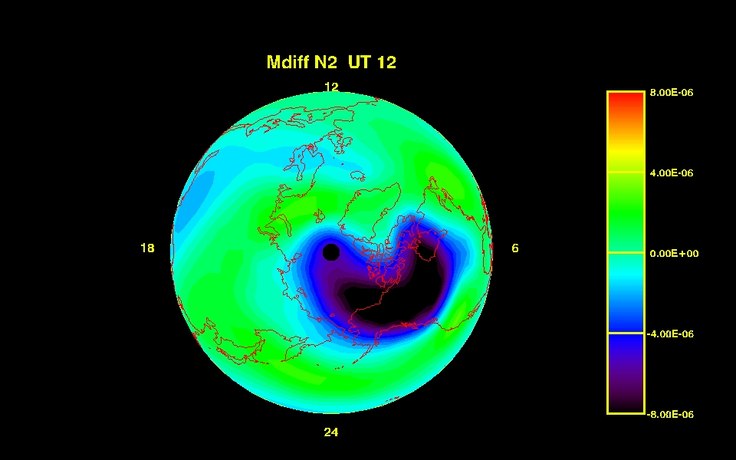
Compositional Forcing (storm)
N₂ mmr
Vertical Advection
Horizontal Advection
Molecular Diffusion

Slide 12
N2mmr movie for a storm

Slide 13
Changes in Neutral Temperatures

Slide 14
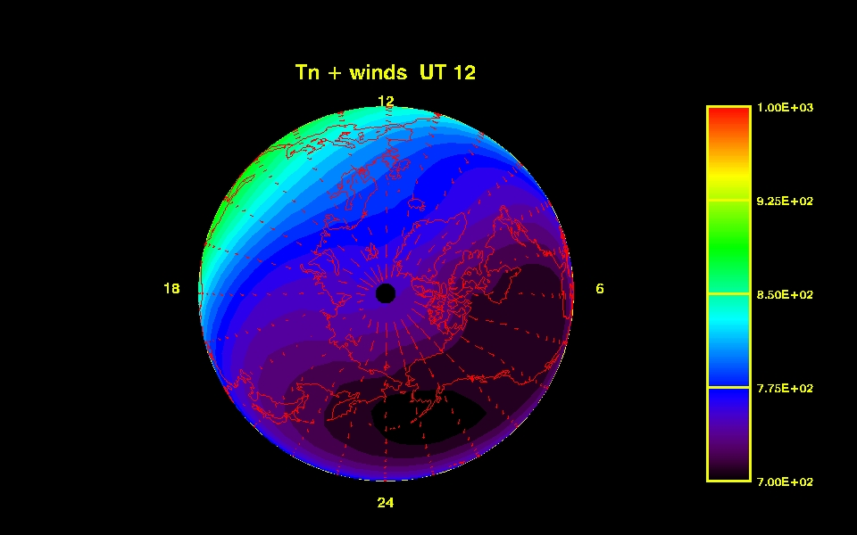
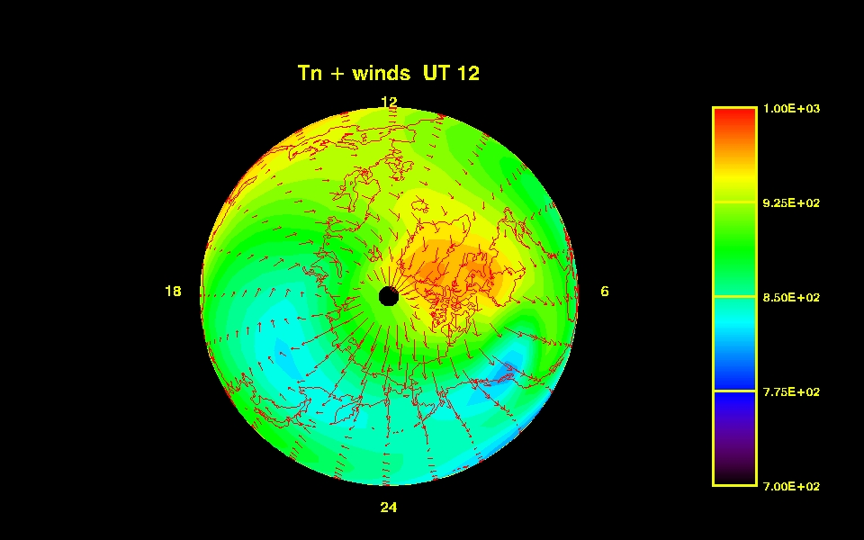
Temperature Changes in the Upper Thermosphere during Geomagnetic Storms
Quiet
Storm

Slide 15
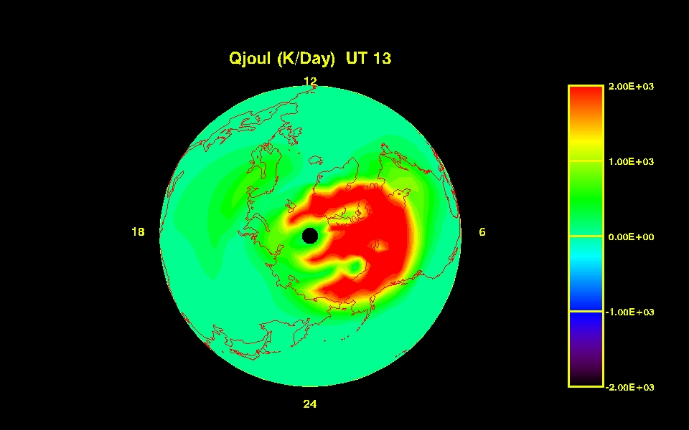
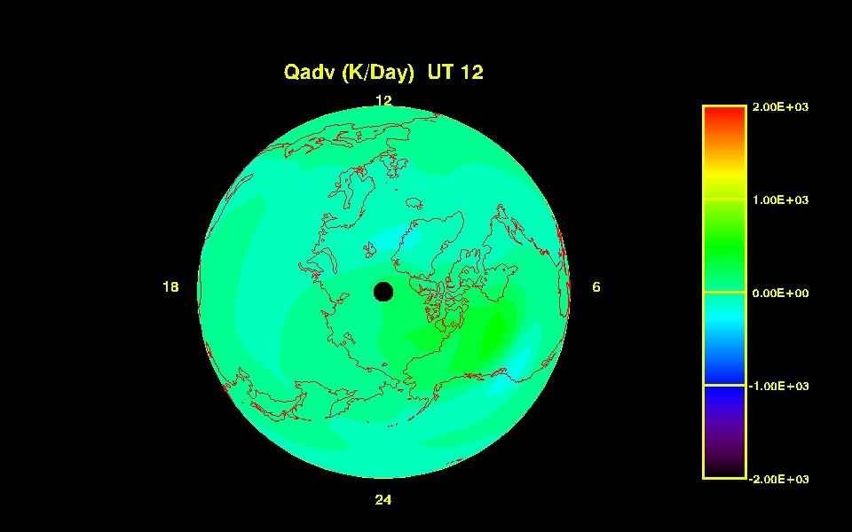
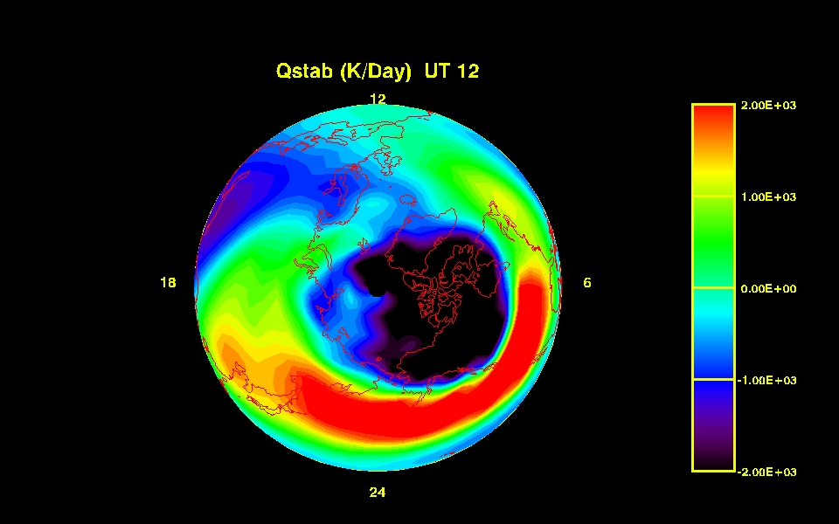
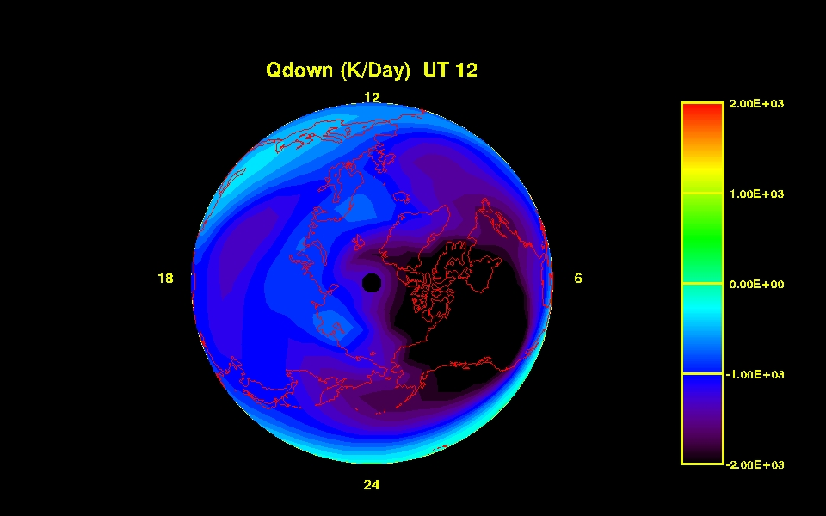
Thermal Storm Forcing (K/Day)
Joule
Advection
Compression and expansion
Conduction

Slide 16
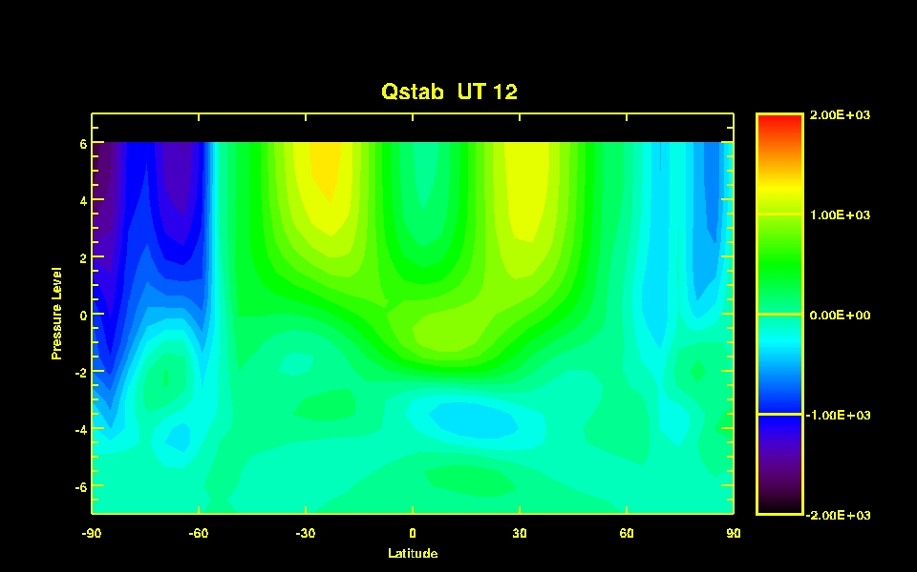
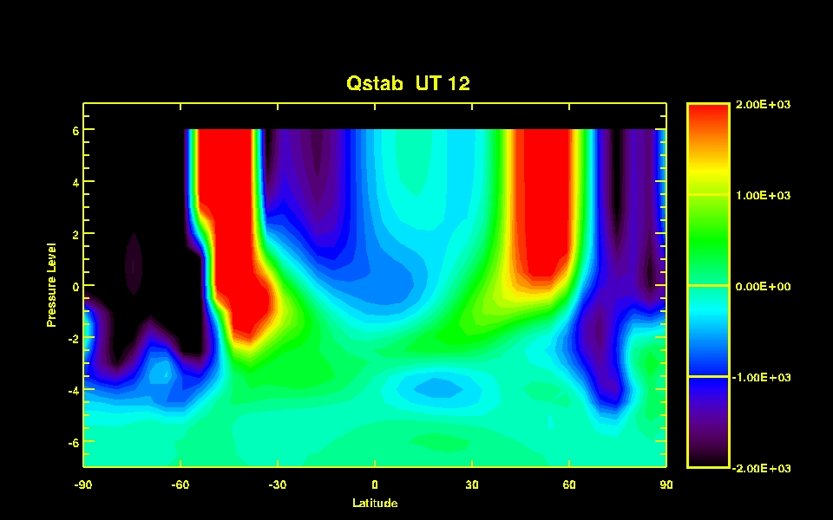
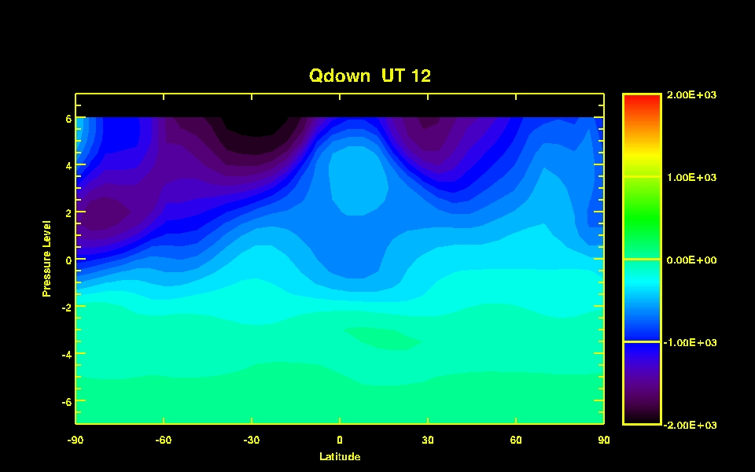
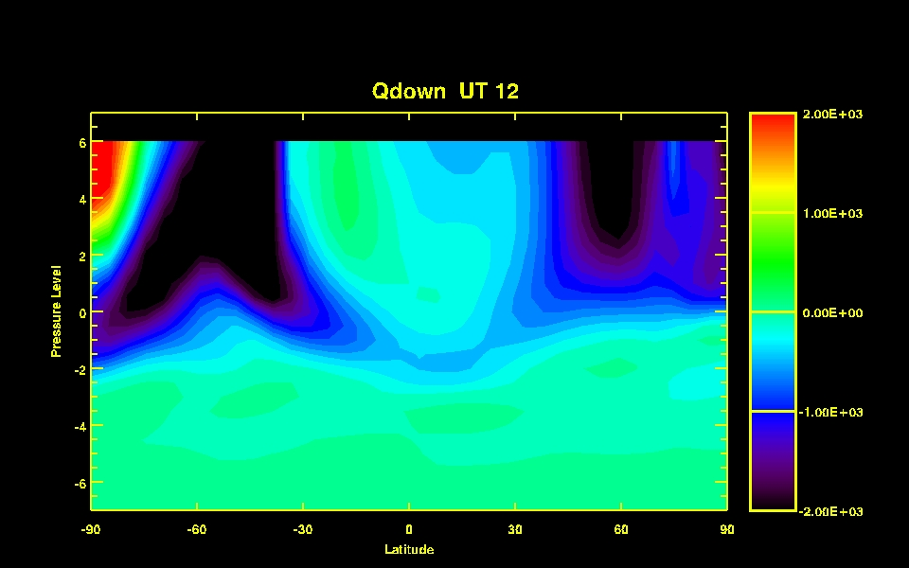
Changes in Low Latitude Thermal Forcing
Compression and Expansion
Compression and Expansion
Conduction
Conduction
Quiet
Storm

Slide 17
Temperature Evolution during the AGU Storm

Slide 18
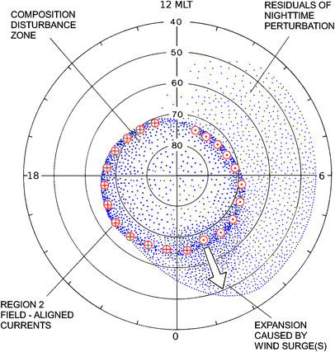
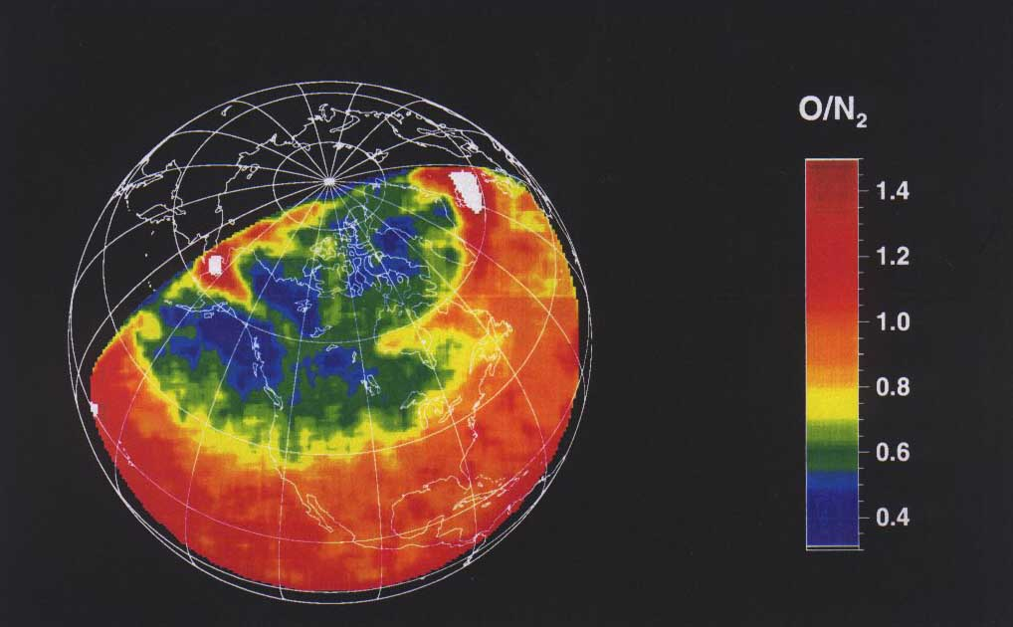
Compositional Disturbances During Geomagnetic Storms
Prolss (1981, 2011)
Strickland et al.

Slide 19
Compositional Changes Caused by Storms
GUVI
325
324
323
322
Crowley

Slide 20
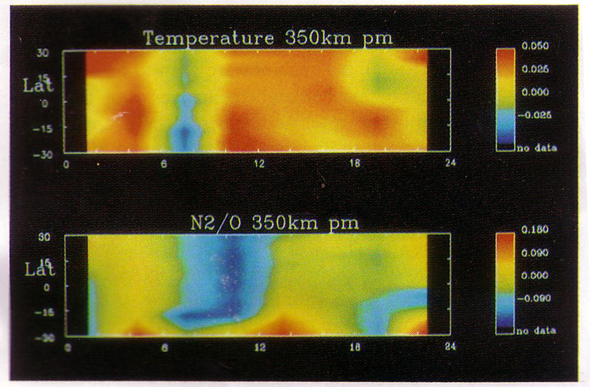
Temperature and Composition Changes with Storm Time
Burns and Killeen, 1992

Slide 21
Temperature Changes
(Storm - Quiet)
Burns et al., 1995

Slide 22
What Measurements do we need to Improve our Models?
Treat the thermosphere and ionosphere as a global weather system

Slide 24
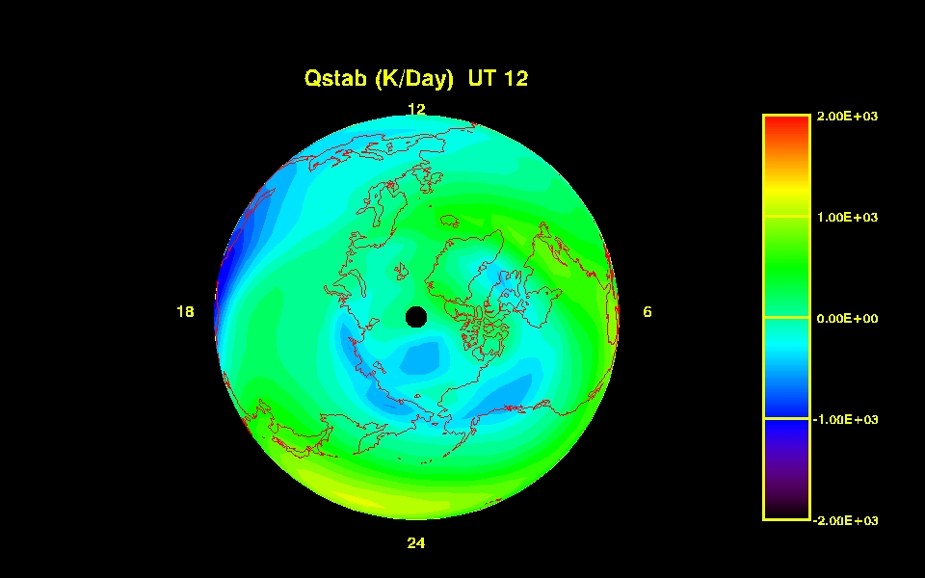
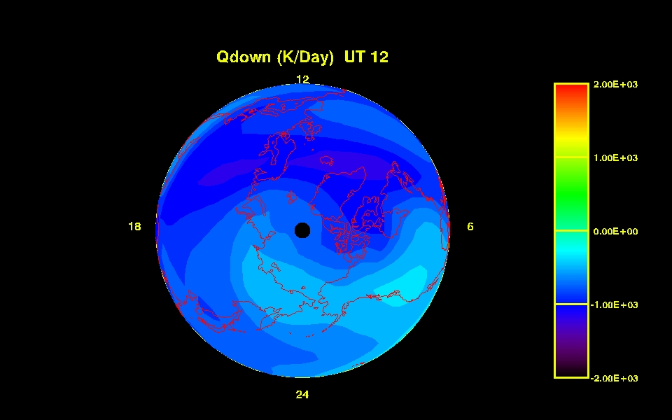

Slide 25
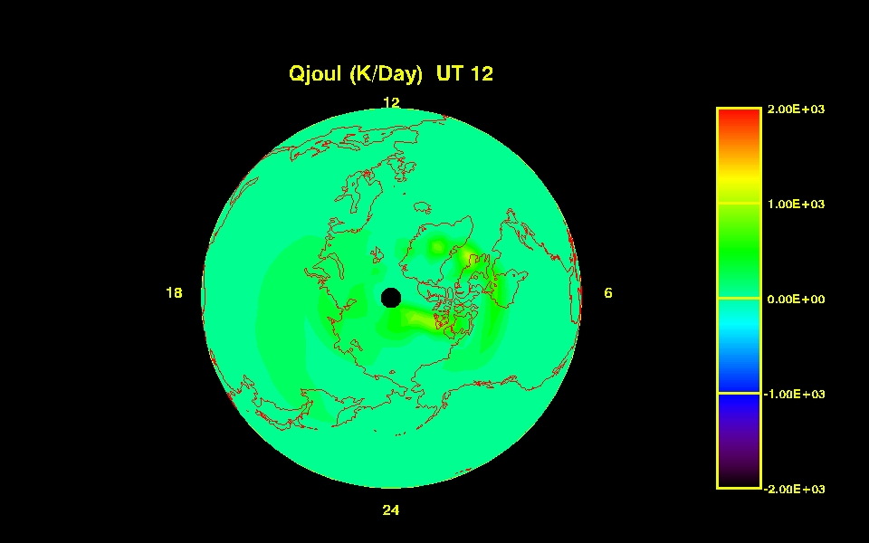
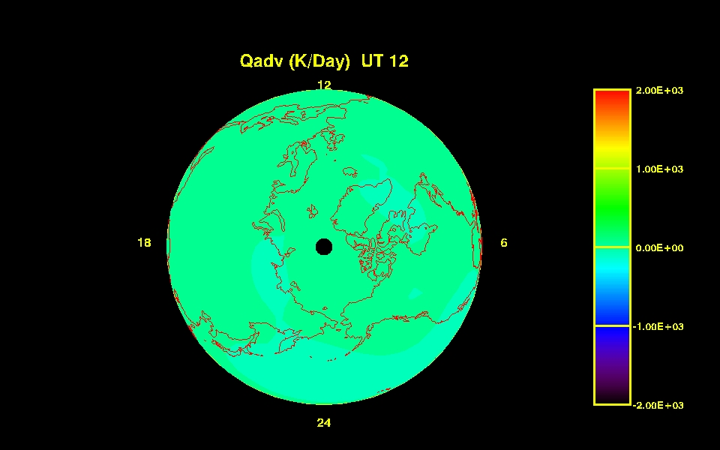
Causes of Temperature Changes

Slide 27
Prolss (1981, 2011)
27

